Slide 1
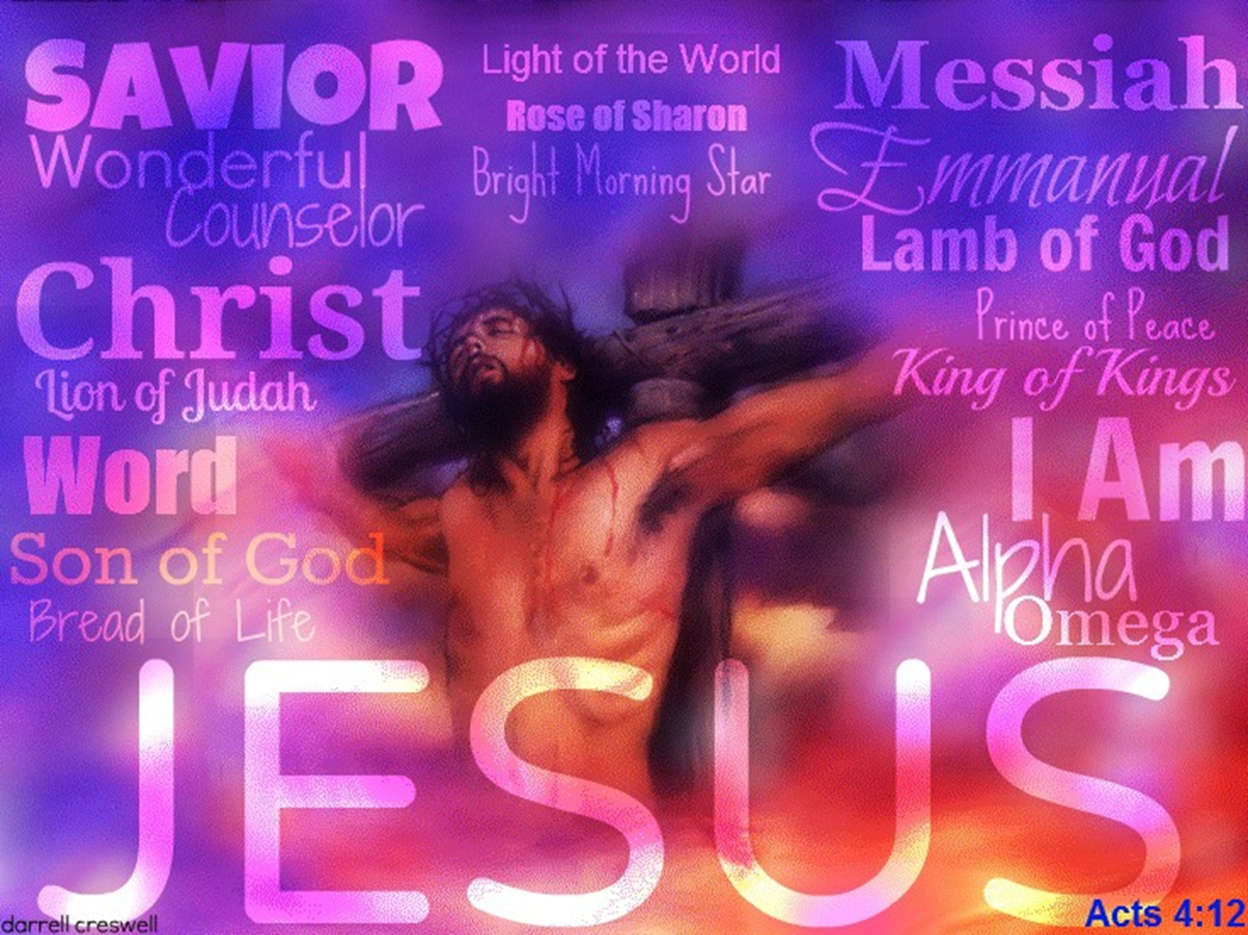
Sharing
the Need
for Christ

Slide 2
The Human Condition
Rom 3:23 “For all have sinned & fall short of the glory of God.”
Isa.53:6 "For all we like
sheep have gone astray.”
Eccl 7:20 “There is not a righteous man on earth who continually does good and who never sins.”

Slide 3

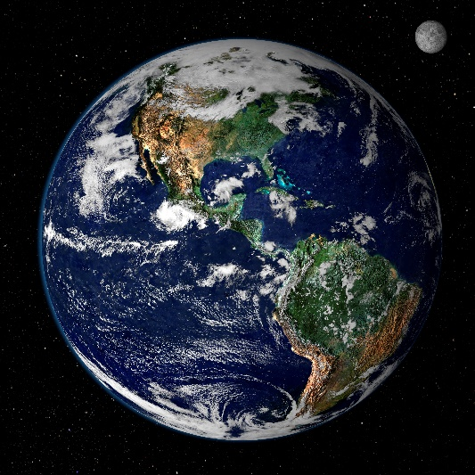
How Widespread is Sin ?
Rom 1:29 “greed, envy, murder,
deceit, gossips, v30 disobedient
to parents..”
Rom.3:14 “Whose mouth
is full of cursing & bitterness."
1Cor 6:9 “Immoral, adulterers,
homosexuals, drunkards..”
Eph 4:28 “stealing, unwholesome words,
rage, clamor (yelling), slander be put away.”

Slide 4

Calculating Sins Age 20/30
(1 John 5:17) All unrighteousness is sin.
How many times age
10 up has average person:
1. Lied? 1 wk __; x52 wks ____; x20 yrs ____
2. Swear? 1 wk__; x52 wks ___; x20 yrs ____
3. Gossip? 1 wk__; x52 wks____; x 20 yrs___
4. Cheated? (tests, sports, games, job)_____
5. All bad thoughts? 52 wks___; x20 yrs ____
6. Broken speed & traffic laws? x15 yrs_____
7.Total Sins for God to forgive ____________

Slide 5


Man’s Hopeless State
Other People can’t pay
for our sins. (Rom 3:10)
Animals can’t pay for
our sins. (Heb 10:4)
Money can’t pay for our sins. (Ps 50:10-12)
Good Works can’t pay for out sins. (Isa 64:6)
If the Lord is a RIGHTEOUS judge (Ps 7:11)
He must also abide by His own laws and
can’t simply let us go without penalty.
So, man was without hope (Eph 2:12)

Slide 6
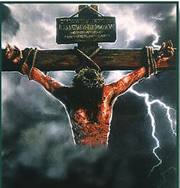
Man’s Need for Christ
Isa 53:5 He was pierced thru
for our transgressions, He
was crushed for our iniquities.
The chastening for our well-
being fell upon Him.
Isa 53:6 “The Lord has caused the iniquity of us all to fall on Him.”
Rom 6:23^{b} "The free gift of God is eternal life in Christ Jesus.”

Slide 7

God’s Plan of Salvation
A. Faith in Jesus as Son:
(John 8:24; Acts 4:11)
B. Repentance from sin:
(Acts 3:19; 17:30)
C. Confession of faith:
(Rom 10:9-10; 1Tim 6:12-13)
D. Baptism into Christ: Gal 3:27

Slide 8


Christian
Have you ever been baptized? _______________
How were you baptized? ____________________
Why were you baptized? ___________________
WHO? Mk 16:15;__________ Acts 2:38_________
HOW? Rom 6:3-4; Acts 8:38 __________________
WHY? Acts 2:38; Acts 22:16; 1Pet.3:21__________

Slide 9

Christian’s Commitment
Your Body: (Rom 12:1; 1Cor 6:20)
Your Mind: (Rom 12:2; 1Pet 3:21)
Your Words (Eph 4:15-16,25,29)
Your Emotions (Eph 4:26,31-32)
Your Actions: (Mat 7:21-23; 1Cor 10:31-33)
Your Relationships (Mat.10:37; Acts 5:29)
Your Finances (1Tim 5:8 & 2Cor 8:3-4)
Your Family (Eph 5:22- 6:4)
Your Future (Phil 3:13-14; Mat 6:21)
Your life (Mat 10:38-39; Rev.2:10)

Slide 10

"Determination is often the 1st chap-ter in the book of excellence."
Are you ready
to begin running
your Race?
(Heb 12:1)

