Slide 1

The Book of

Slide 2

The Name of the Book
A. TITLE: APO-KA- LUP-SIS (Rev 1:1) “Revelation of Jesus Christ”
Disclosure: “A disclosure of truth.. concerning divine things before unknown.” Thayer‘s Greek Lexicon
Uncovering: “A drawing away by Christ of the veil of darkness.”
Vine’s Expository Dictionary
It’s Revelation—Not book of “RevelationS”

Slide 3
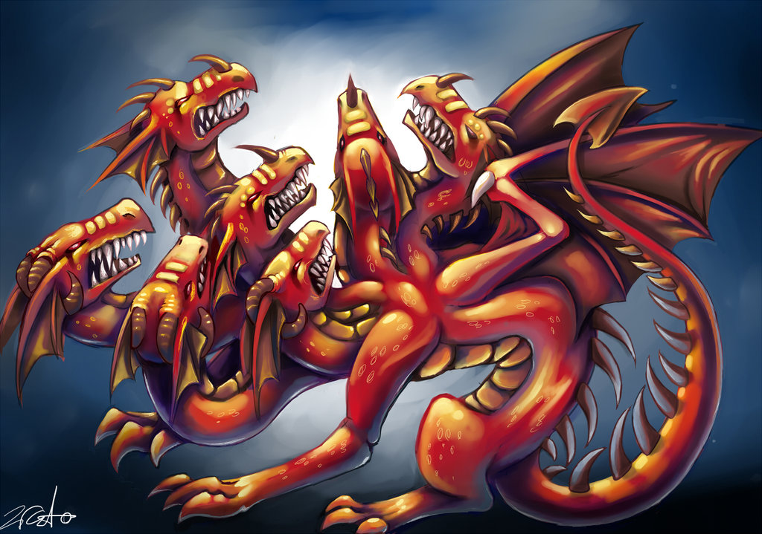
The Language of this Book
Most everybody
recognizes that
Revelation is a
book of SYMBOLS.
A symbol (word, picture, sign) stands
for something else that is REAL.
Satan is REAL , yet not a LITERAL Red
7-headed reptile in outer space. (Rev 12:3)
It’s Biblical code for Christians to understand.
(Rev 1:1a) “The Revelation …which God gave Him to SHOW to His bond-servants.”

Slide 4

Key to Understanding this Book
The KEY to understanding this book is the Old Testament. PERIOD.
There are 404 verses in Revelation and 400 symbols come from the OT.
So when we encounter a symbol
let’s see what the context says, then go
to the OT to see the meaning given to it.
Christians were meant to understand it
and Roman persecutors were not.

Slide 5
OT Key to Understand Revelation
Dan 10:5 “There was a certain man dressed in linen, whose waist was girded with a belt of pure gold.”
Rev 1:13 One like a son of man, clothed in a robe reach-ing to the feet, and girded across His breast with a golden girdle.

Slide 6
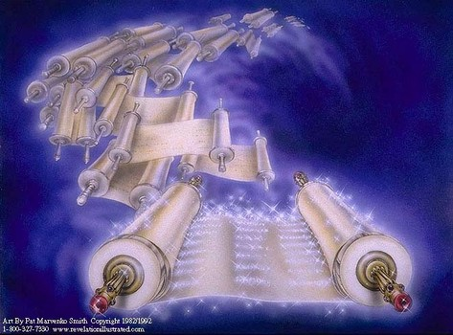
OT Key to Understand Revelation
Book of Life
Ps 69:28 “May they be blotted out of the book of life”
Rev 3:5 “He who overcomes shall thus be clothed in white garments; and I will not erase his name from the book of life”

Slide 7

OT Key to Understand Revelation
Ezek 1:5, 10
Living Beings
Rev 4:6-8

Slide 8
OT Key to Understand Revelation
1. Throne Vision (Rev 4; Ezek 1).
2. Plagues (Rev 6:1-8; Ezek 5:12).
3. Seal on Faithful’s foreheads (Rev 7:3-4 Ezek 9:4)
4. Eat the Book (Rev 10:8-11; Ezek 2:8)
5. Measure the Temple (Rev 11:1-2; Ezek 40:5ff)
6. Jerusalem & Sodom (Rev 11:8; Ezek 16)
7. Great Harlot (Rev 17:1 15ff; Ezek. 16:15ff).
8. Scavengers feast (Rev. 19:17-18; Ezek 39:4)
9. First Resurrection (Rev 20:4-6; Ezek 37:10).
10 War of God & Magog (Rev. 20:7-9/Ezek 38-39)
11 New Jerusalem (Rev 21:2; Ezek 40:2)
12 River of Life (Rev 22; Ezek 47:1-9)

Slide 9
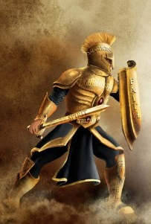
Purpose: Book of Revelation:
Our VICTORY over Satan !
Christianity: Suspect Religion
Won’t worship Caesar
Worship a Criminal
Eat human flesh
Drink Blood
Rome threw everything
at them and lost !
Rev 6:9 Your blood will be avenged.
Rev 8:3,5 Your prayer changes things.
Rev 15:2 Your victory is assured. (20:9-10)

Slide 10
Author of Book of Revelation
Rev 1:4 “John to the seven churches”
Rev 1:9 “I John, your brother”
Rev 22:8 “I John am the
one who saw
these things.”
Early writers said: John!
Justin Martyr 140 AD
Irenaeus 180 AD
Tertullian 220 AD
Origen 223 AD
Early Christians universally JFB
Modern critics
deny it on stylistically
differences.

Slide 11
Date Revelation was Written
Controversial, but traditional date is AD 96
The historian Eusebius quoted Irenaeus’ testimony that John wrote the book of
Revelation near the end of Domitian’s reign.
Domitian was executed in 96 A.D.
“If it were necessary that his name [Antichrist] should be distinctly revealed in this present time, it would have been announced by him who beheld the apocalyptic vision. For that was seen no very long time since, but almost in our day, towards the end of Domitian’s reign.” [ie AD 96] —Irenaeus

Slide 12
Date Revelation was Written
Rev 1:9 “I John, your brother and fellow partaker in the tribulation and kingdom and perseverance which are in Jesus, was on the island called Patmos, because of the word of God and the testimony
of Jesus.
AD 96
“Eusebius also quoted Hegesippus’ about
(AD 150) that John returned to Ephesus
upon being released from exile after the
accession of Nerva in AD 96 (HE III. xx).”
Nerva was the successor to Domitian

Slide 13
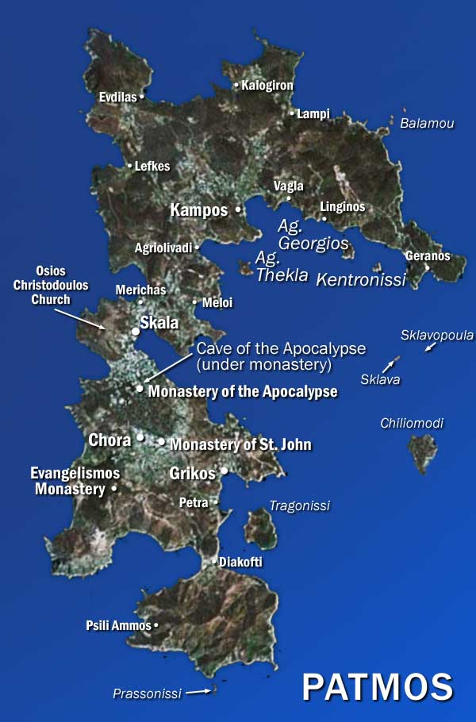
Date Revelation was Written
“There is no question that Revelation was written while John was a prisoner of the Roman state, exiled to the prison island of Patmos.”¹
“All ancient sources, both Christian and secular, place the banishment of Christians to Patmos during the reign of Domitian (AD 81-96). Not a single early source (within 500 years of John) places John's banishment under the reign
of Nero, as Preterists claim.”²
^{1,2} Pristine Faith Restoration Society (www.pfrs.org/preterism)

Slide 14
Date Revelation was Written
Revelation was written about AD 96
Time for the 7 churches needed to grow & decline.
The Ephesians had left their first love (Rev 2:4).
The Laodicians had their city destroyed (AD 60)
then rebuilt and grew apathetic.
Great Harlot drunk with the blood of martyrs, is the “Great city which rules over the kings” (Rev 17:18).
Jerusalem DIDN’T RULE kings in the first century…
it WAS RULED. Jerusalem was a small provincial religious city in a small country.

Slide 15
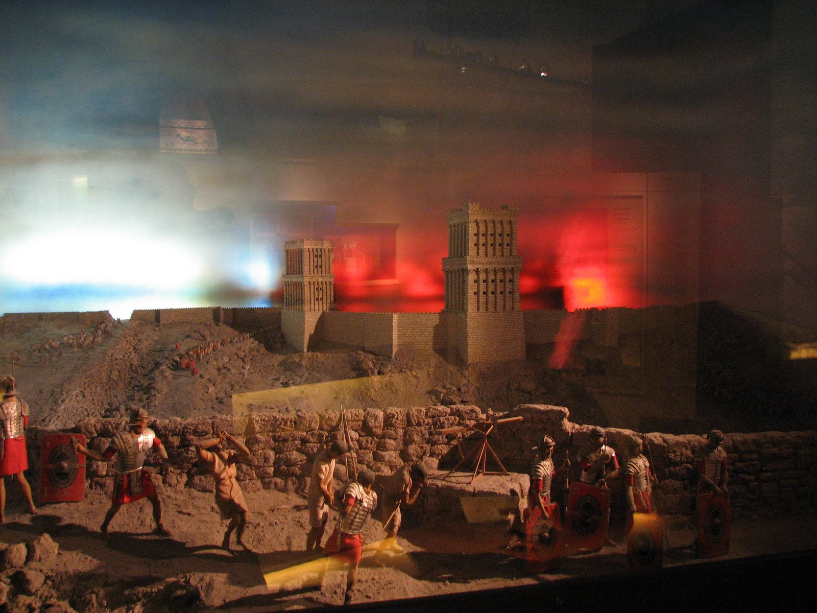
Methods of Interpretation
Preterist (fulfilled) Early date AD 69.
Destruction of Jerusalem held by authors
Foy E Wallace; Arthur Ogden: Avenging of
the Apostles & Prophets. This requires a
date of John’s writing about 65-69 AD
Does (Rev 17:9-12) apply to Nero died 68 AD?
Is Temple still standing? (Rev 11:1-19)
Problems AD 69: No emperor worship
and exile not well established?

Slide 16
Methods of Interpretation
World Historical Method.
Rev 6 Seven Seals = Roman Persecution 96-365 AD
Rev 8 Trumpets = Barbarian conquests 500’s AD
Rev 10 Strong Angel = Reformation w Wycliffe &
Luther Bible being given to the people.
Rev 11 7th Trumpet= French Revolution (1792-1795)
Loss of papal power.
Rev 13 Beast = Catholic church pope Alexander III
issued sanctions against heretics.
Rev 16 Bowls = Napoleon becomes the emperor, arrests pope 1809. Decline of the Papacy:

Slide 17
Methods of Interpretation
World Historical Method cont.
Held by John Wycliffe, Martin Luther, Albert Barnes;
JT. Hinds Gospel Advocate Commentary.
Summers: Worthy is the Lamb Commentary.
Problems with this Theory? Highly Speculative.
The “666 of (Rev 13:18) has been interpreted as Nero; Luther; Diocletian, Man, Roman, Trajan; Mohammed; Pope Benedict IX; and Napoleon.
If the Name won’t work—try the Title.
If it won’t work in Greek—try Hebrew or Latin.
If right spelling won’t work, try variants or defective.

Slide 18
Premillennial View
Held by Hal Lindsey, John Walvorood,
and is popular with most denominations.
They hold that The Revelation deals with up -
coming battles of Russia & China vs. Palestine.
Problems with this theory:
Makes Jesus False to his promises (Mk 1¹⁴⁻¹⁵)
Means gentiles Can’t yet be saved (Acts 15¹⁴⁻¹⁸)
Belittles Christ’s Church as afterthought (Eph 3⁹⁻¹¹)
Makes 1st coming a Failure (Gal 4⁴⁻⁵; John 17¹⁻¹⁴)
It Mixes Judaism & Christianity (Heb 8⁵⁻⁷; 9⁹⁻¹⁰)
It Denies Christ now reigns (Acts 2³³⁻³⁶; 1Cor 15²⁵⁻²⁷)

Slide 19
Dispensational View
Premillennial DISPENSATIONALISM— claims 7 Churches are “ 7 AGES ”
Ephesian age 50- 170 Paul, The Church Age
Smyrna age 170-312 Irenaeus Age of persecution?
Pergamum age 312-606 Age of pagan rituals?
Thyatira age 606-1520 Catholic church growth?
Sardis age 1520-1750 Luther; Age of justification?
Philadelphia age 1750-1906 Wesley; sanctification?
Laodicea age 1906-present; Age of Cult leaders?
Absolutely arbitrary and with no hint of legitimacy.

Slide 20
Traditional Biblical View
Fall of Rome: Author Jim McGuiggan:
The Book of Revelation.
Most authors of antiquity assert AD 96 is the time.
Justin Martyr 140; Irenaeus 180; Tertullian 220;
Origen 223, and early churches universally JFB
(Rev 1:9) exile was common practice. (Rev 3:17) Laodicea had an earthquake that destroyed the city AD 60 & needed time to rebuild & prosper.
Irenaeus AD 180 testifies that Revelation was written near the end of the reign of the
emperor Domition. (AD 96)

Slide 21

How Soon Would Events Happen?
Rev 1:1 “Things which must shortly
come to pass.” (2:16)
Rev 1:19 Write therefore the things which you (a) have seen, and the things (b) which are, and the things which shall take place
(c) after these things.
Rev 20:3 Until the thousand years were completed; after these.
(Some things happen much later)

