Slide 1
How to Honor Jesus Our Lord !
Col 2:8 See to it that no one takes you captive through philosophy and empty deception, according to the tradition of men.
Philo-sophy: love of wisdom.
“Greeks thought it the highest
effort of the intellect. The gospel deposed it as inadequate.” Vines.
Vain deception: “Void of anything profitable” Vines.
Not the latest buzzword, psycho-babble but JESUS!
Serial killers brains look different. They’re still killers
Notes:
Do you know that serial killer’s brains
look a little different from ours?
So WHAT??? It’s still murder !!!

Slide 2
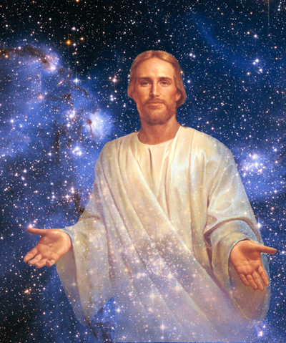
How to Honor Jesus Our Lord !
Col 2:9 For in Him all the Fullness of Deity
dwells in Bodily form.
The Divine Nature is fully
present in the human
person of Christ.
Gnostic heretics claimed
Jesus was an intermediary
angel with no actual body
--only an apparent body!
Here Paul affirms Christ was both fully God and truly Man. ( See also 1 John 4:2-3)

Slide 3

How to Honor Jesus Our Lord !
Col 2:12 Having been buried with Him in baptism, in which you were also raised up with Him through faith in the working of God, who
raised Him from the dead.
YOU MADE
A LIFE-LONG
COMMITMENT
YOU ARE
RAISED TO
A NEW LIFE
YOU ARE
ALIVE !

Slide 4
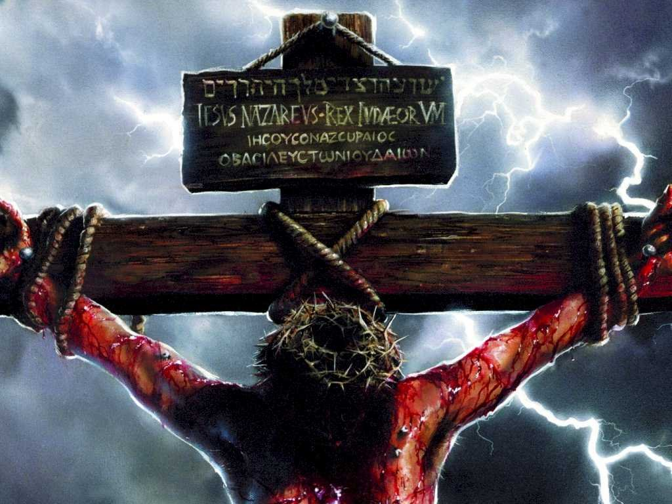
How to Honor Jesus Our Lord !
Col 2:14 Having canceled out the certificate of debt consisting of decrees against us and which was hostile to us; and He has taken it out of
the way, having nailed it to the cross.
Eph 2:15 Law of commandments in ordinances
BEC: He took the Law to the cross & nailed it there.
Barnes, Robertson: “Writings of the Mosaic Law.”
Our sins were nailed there, (1 Pet 2:24) but also was
The Old Law. Compare Calvin, Coffman, JFB, BKC.
Notes:
Coffman-- Written in ordinances: this verse,
signifies the tables of stone inscribed by the
finger of God…The Decalogue is here indicated.

Slide 5
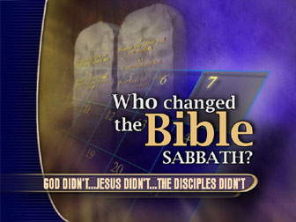
How to Honor Jesus Our Lord !
Col 2:16 Therefore let No one act as your judge in regard to food or drink or in respect to a festival or a new moon or a Sabbath day.
Eat pork or lobster if you wish.
1 Tim 4:3-5 “Everything is Good
& nothing to be rejected.”
SDA
Ask:
Jewish festivals are not required of Christians !
(Deut 5:3)
Col 2:20-23 Don’t Submit to food laws.
(Meat, soy, wheat, etc)
God Did (Col 2:14-16)

Slide 6
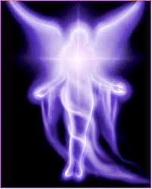
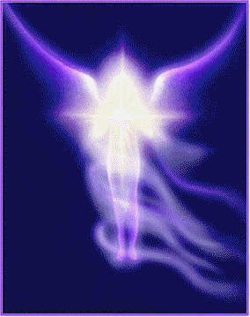
How to Honor Jesus Our Lord !
Col 2:18 “Let no one keep defrauding you of your prize by delighting in self-abasement …taking his stand on visions he has seen.”
Worship of Angels: False teachers appearing too humble to dare to approach God.. call on angels. JFB
Heretics claimed angels accompany them in everyone of their sinful and abominable actions
and urge them on. And they pray to that angel. Irenaeus: Against Her. Bk 1, ch 31, v2.
Some claim a vision. Or ungodly one was told he & his sons were going to Heaven. (2 Cor 11:14)
Notes:
Irenaeus (130-202AD): Against Heresies Bk 1, Ch 31, v2.
“An angel, they maintain, attends them in every one of their sinful and abominable actions, and urges them to venture on. Whatever may be the nature of the action, they declare that they do it in the name of the angel, saying, O you angel, I use your work; O you power, I accomplish your operation! And they maintain that this is perfect knowledge.”

Slide 7

How to Honor Jesus Our Lord !
Col 3:1 If then you have been raised up with Christ, keep seeking the things above,
where Christ is…
Focus on eternal priorities, rather than earthly.
Righteousness Mt 6:33
Building up saints Hb 10:24
Growing Spiritually Eph 4:15
Really Loving others Mt 22:39
Reaching others for Christ Dan 12:3
Setting our hearts on Heaven 1 Pet 1:13

Slide 8
How to Honor Jesus Our Lord !
Then you also will be revealed with Him
in GLORY.
Col 3:4 When
Christ,
who is
our LIFE,
is revealed..
Christ is your life: His is the real source, meaning, purpose, and destiny of our life. cf UBS
The rest of the chapter tells us
how to live for Him & honor Him till He returns.

Slide 9
How to Honor Jesus Our Lord !
Col 3:5 Therefore consider the members of your earthly body as dead …to
v.5 Immorality, impurity, passion, evil desire,
and greed...
v.8 Put aside *
anger, wrath,
malice, slander,
abusive speech
v9 Do not lie to one another, since
you laid aside the Old self with its
evil practices, 10 and have Put on* the New self”
(Don’t exaggerate, misrepresent, or just plain lie.)
Notes:
*Put Off: Our Colorado the family has pigs and they love to wallow
in the cool mud and muddy water—and when they get
out they want to shake off excess. Then yer muddy.
Or if you’re working on heavy equipment—yer dirty.
*Put on: Now it’s time to put on clean clothes
and have dinner, play with family or go to church.

Slide 10


How to Honor Jesus Our Lord !
Col 3:12a As those who have been CHOSEN
of God, holy and beloved… (Here’s who you are)
Mt 22:2-14 The Chosen are the Willing Obedient.
“ Put on a heart of compassion, kindness, humility, gentleness and patience; 13 bearing with one another, and forgiving each other,
just as the Lord forgave you. ”
The key to forgiving others is remembering
HOW MUCH the LORD has forgiven you !

Slide 11

How to Honor Jesus Our Lord !
Col 3:14 AND BEYOND ALL THESE THINGS…
Put on LOVE, which is the perfect bond of unity.
(1 Cor 13:13) But now abide faith, hope, love, these three; but the Greatest of these is Love.
Love is the greatest principle there is !
It’s the glue that holds families & congrega-
tions together and will exist throughout Eternity !
This Last article of clothing holds rest in place.

Slide 12

How to Honor Jesus Our Lord !
Col 3:15 And let the peace of Christ RULE in your hearts, to which indeed you were
called in one body; and be thankful¹.
RULE: Comes from the language of
athletics. An umpire at the games,
has to control, settle strife.”
Kittle
In the conflicts of the heart, we must choose
between opposing elements – by using the
principle of “What will bring peace”
in our souls & churches.

Slide 13
How to Honor Jesus Our Lord !
Col 3:16 Let the word of Christ richly dwell within you, with all wisdom teaching & admonishing one another with psalms & hymns and spiritual songs, Singing with Thankfulness² in your hearts to God.
a. The OT used instrumental music
for 1,000 years. (2 Chron 29:25)
b. But NT music was vocal ONLY
& ALWAYS in the early church!*
c. But the emphasis: (1) Scriptural, (2) wisely done, (3) admonish others, (4) with spiritual songs—
(5) sung with “Thankfulness in your hearts..”
Inventory memories, abilities, family, relationships..

Slide 14
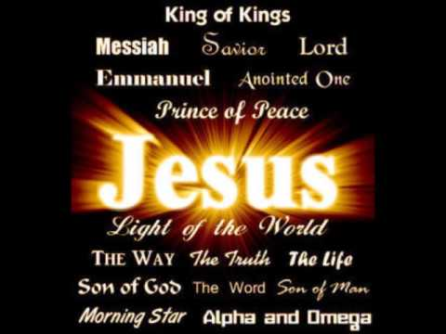
How to Honor Jesus Our Lord !
Col 3:17 And whatever you do in word or deed, Do All in the Name of the Lord Jesus, giving thanks³ through Him to God the Father.
Respect His authority Christ in everything: (1) Morality; (2) In Worship; (3) In every Thought and Action
(4) In secret purposes of the Soul. (Ps 19:14)
With Thanksgiving mentioned 3X in 3 verses.

Slide 15

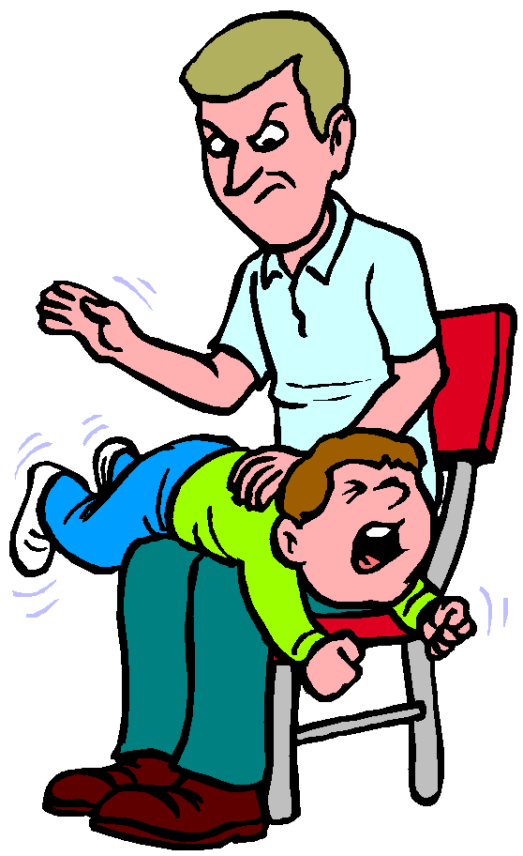
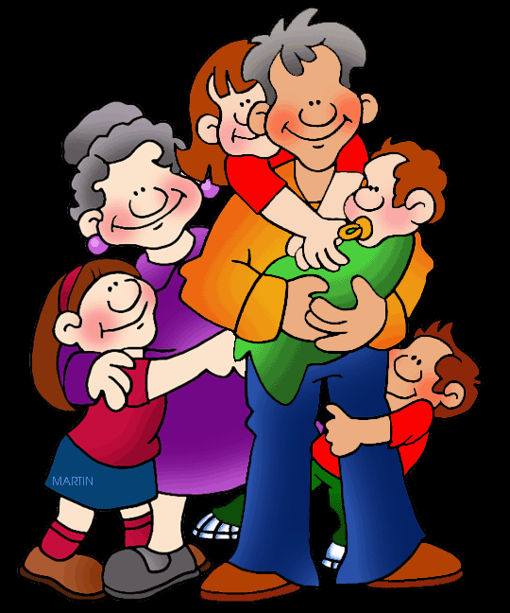
Col 3:17 Do All in the Name of the Lord
Every thought & Action by His Authority
What if Court says Homosexuality is right? (cf 1 Cor 6:9) You say?
What if Society says
“Don’t Spank you kids”?
(Prov 13:24) You say?
RCW 9A.16.100
What if Others say
you don’t need to go to
Church? (cf Heb 10:25)
Notes:
Our state does NOT allow corporal punishment
in public schools. Lawmakers banned that in 1983.
RCW 9A.16.100 Physical discipline is legal by
parents or guardians.

Slide 16

Summary:
How to Honor Our Lord !
1. Know Jesus trumps philosophy
2. Rise to a New Life after baptism
3. You’re not judged by the Old Law
4. You’re not swayed by Fake Visions
5. See YourSelf DEAD to the old sins
6. Get transplant of forgiveness
7. Put on Love—the perfect bond of unity
8. Let PEACE of Christ rule in your hearts
9. Sing with Thankfulness in your hearts
10. In all you do– operate by His Authority

