Slide 1

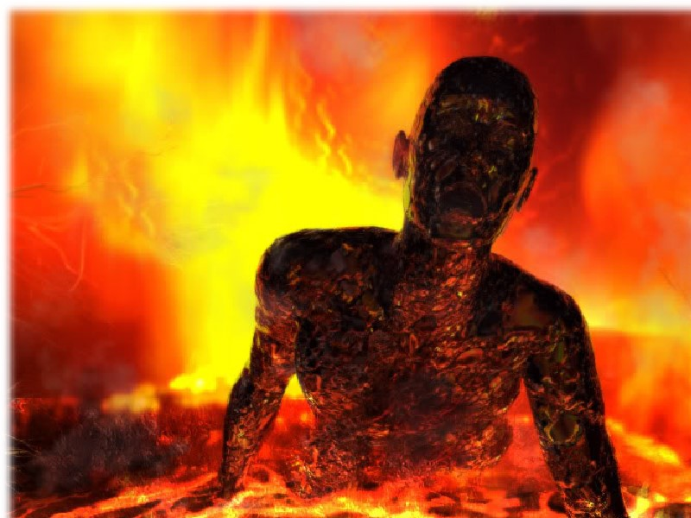
Jas 3:13-18 Two Kinds of Wisdom
v.15a Wisdom …which comes from above.
v.15b Or from
below…
.. earthly,
natural, demonic.

Slide 2

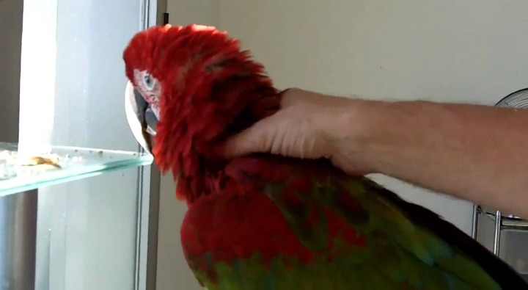
Jas 3:1-12 The Problem of the Tongue
Man was given a parrot as a gift.
Parrot spoke terrible profanity at the worst times.
The man tried everything: teaching good words,
soothing music, cover over the cage. Nothing works.
In frustration the man grabbed the parrot threw it
in the freezer with the rest of his food.
It squawked, flapped & banged about, then silent.
The man opened the door, saw parrot shivering!
He said “Don’t talk like that again or you’ll get worse!
Parrot agreed then asked: “what
did the turkey do?

Slide 3

Jas 3:13-18 Two Kinds of Wisdom
James 3:13 Who
among you is wise
and understanding?
There were problems of jealousy and selfish ambition among them. v.14
Wisdom : Having the power of discern & judge properly what is right. Makes good decisions.
Understanding: Has the experience, especially having the knowledge of an expert. Thayer

Slide 4
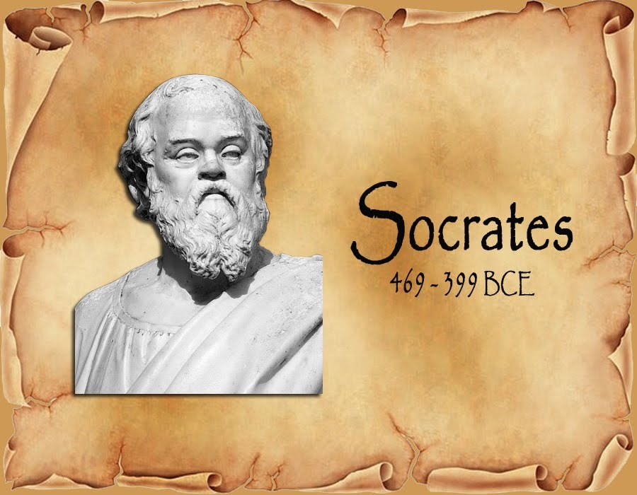
Jas 3:13-18 Two Kinds of Wisdom
Proud young man came asking for wisdom
Notes:
A proud young man came to Socrates asking for wisdom.
He walked up to him and said, “O great Socrates, I come to you for wisdom.”
Socrates, led him down to the sea and took him chest deep into the water.
Then he asked him, “What did you say you wanted?”
“Wisdom, O great Socrates,” said the young man.
Socrates put his strong hands on the man’s shoulders and pushed him under.
Thirty seconds later Socrates let him up. “What do you want?” he said again. “Wisdom, Oh great Socretes.”
Socrates pushed him under again. Forty seconds– then Socrates let him up.
The man was gasping. “What do you want, young man?” Between heavy breaths the fellow gasped, “Wisdom!”
Socrates jammed him under again –fifty seconds – then he let him up.
“What do you want?” The young man yelled. “Air, I need air!”
“When you want wisdom as much as you have just wanted air, then you will begin to find wisdom.”

Slide 5

Gaining Godly Wisdom
Ps 111:10 Fear of the Lord is the beginning of Wisdom
Ps 19:7 The testimony of the Lord is sure, making wise the simple [in-experienced].
Prov 13:20 He who walks with wise will be wise.
Prov 10:19
When there are many words, transgression is unavoidable, but he who restrains his lips is wise.
Prov 12:18 The tongue of the wise brings healing.
Prov 11:30 He who is wise wins souls.

Slide 6
Jas 3:13-18 Two Kinds of Wisdom
Deut 4:5 “I have taught you statutes and judgments … v.6 So keep and do them, for
that is your Wisdom and your Understanding.
People who used the Worldly Wisdom:
1. Eve thought my way is better than God’s. Gen 3
2. David sent for Bathsheba & covered up. 2 Sam 11
3. Lot moving to Sodom to be prosperous. Gen 13
4. Saul offers sacrifice for before battle 1 Sam 13
5. Peter rebukes Jesus for pessimism. Mk 8:33

Slide 7
Jas 3:13-18 Two Kinds of Wisdom
James 3:13 “Who among you is wise and under-standing? Let him show by his good behavior his deeds in the gentleness of wisdom.”
If you got expert knowledge & make good decisions
then show it by how you act !
2 Tim 2:24 “And the Lord's bond-servant must not be quarrelsome, but be kind to all, able to teach,
patient when wronged.”
Kind: [epios] mild, friendly, gracious, pleasant.
Not aggressive, hostile, over-bearing, arrogant.
It’s not about getting ‘em told. You are a servant.

Slide 8
Jas 3:13-18 Two Kinds of Wisdom
2 Tim 2:25 With gentleness correcting those who are in opposition, if perhaps God may grant them repentance leading to the knowledge of the truth.
Gentleness: [4240 prautes] Louw: Humility, gentle-ness of attitude and behavior, in contrast with harshness in one's dealings with others, mildness.
2 Tim 4:2 “Preach the word; be ready in season and out of season; reprove, rebuke, exhort, with great patience and instruction.”
Some don’t want you to be preaching about hell, homosexuality, or One true church! You can’t quit!

Slide 9

Jas 3:13-18 Two Kinds of Wisdom
James 3:14 “But if you have bitter jealousy and selfish ambition in your heart, do not be arrogant and so lie against the truth.”
Who’s the better speaker?
Who gets more invitations?
Who gets more compliments?
Who converts or baptizes more people?
Who does more song-leading? Who got what?
Who got promoted? Whose group is growing faster?
CURE? Gal 5:20 Repent, jealousy is a sin. Phil 2:3
Regard others more impt. Heb 12:2 Fix eyes of Jesus

Slide 10

Jas 3:13-18 Two Kinds of Wisdom
NIV James 3:14 But if you harbor bitter envy and selfish ambition in your hearts, do not boast about it or deny the truth.
CEV James 3:14 But if your heart is full of bitter jealousy and selfishness, don't brag or lie to cover up the truth.
Bragging about selfish ambition is sin. I deserve it.
I just work harder. (Jas 4:16) All such boasting is evil.
(Prov 27:2) Let another praise you, not own lips.
Lying about NOT being jealous is a sin. (Eph 4:15)
(Eph 4:25) Laying aside falsehood, speak the truth.

Slide 11

Jas 3:13-18 Two Kinds of Wisdom
James 3:15 This wisdom is not that which comes down from above, but is earthly, natural, demonic.
Wrong ways of moving upward:
1. Speak of your achievements but not the others.
2. Backstab the other person with hints/innuendos.
3. Ignore the Bible condemnations of those actions.
(1 Cor 1:10; Gal 5:20) dissensions, and factions.
ALL SUCH ACTIONS ARE SATANIC

Slide 12
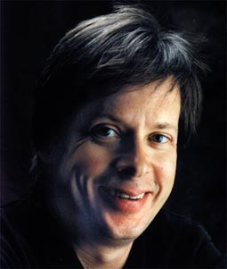
Jas 3:13-18 Two Kinds of Wisdom
“I can argue very well. Ask any of my remaining friends. I can win an argu-ment on any topic, against any op-ponent. People know this, and
steer clear of me at parties.”
“Often, as a sign of their great respect, they don’t even invite me.” — Dave Barry, humorist.
James 3:16 “For where jealousy and selfish ambi-tion exist, there is disorder and every evil thing.”
Souls are lost, congregations split, angry tempers,
gossips, friendships gone, discouragement, pain.

Slide 13
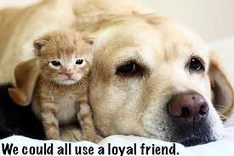
Jas 3:13-18 Two Kinds of Wisdom
James 3:17 “But the wisdom from above is first pure, then peaceable, gentle, reasonable, full
of mercy and good fruits, unwavering,
without hypocrisy.”
This is everything good
in how Christians in a congregation
should be!
Euripides:
One loyal Friend is worth
a thousand relatives!

Slide 14

NIV James 3:18 Peacemakers who sow in peace raise a harvest of righteousness.

