Slide 1
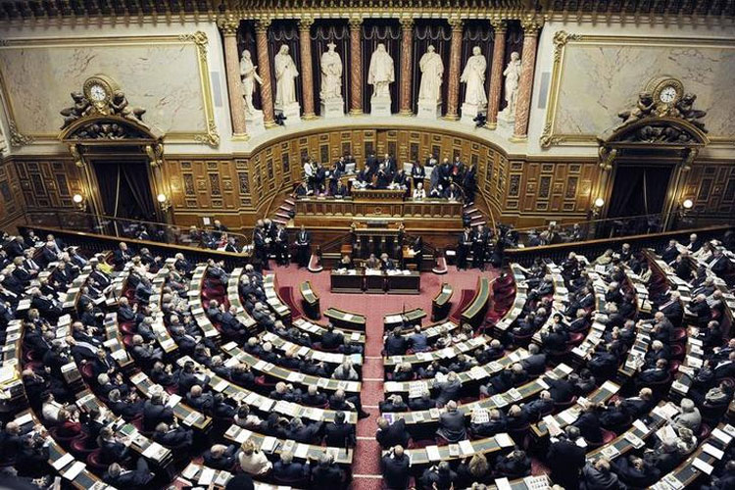
The Gospel of the Left & Right
The terms “Left" and “Right"
appeared during the French Revolution of 1789 when members of the National Assembly divided into supporters of the king to the president's right & supporters of the revolution to his left
In 1791 When the Legislative Assembly convened comprising entirely new members, the divisions continued. “Innovators” sat on the Left, "moderates" gathered in the center, and “Constitutional defenders” were sitting on the right.

Slide 2
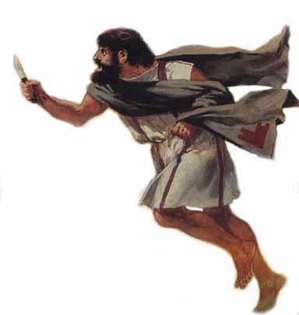
The Gospel of the Left & Right
Left & Right Jewish Spectrum
Who was correct?
NOBODY !
Sacarii
Essenes
Zealots
}
Sadducees
Pharisees
Snakes Mat 3:7-8
Pragmatist
Liberals.
Denied Ressurr,
Angels,
Spirits.
(Acts 23:7)
Own
Traditions.
Hypocrites. Excuse own sin.
(Mt 15:1,9)
(Mt 23:4)
Killers,
assassins
of Roman
soldiers
& sup-
porters
SeparatistsDead Sea Scrolls.
No Temple
Make own
Laws.
Warriors
Patriots,
Revolu-
tionaries.
(Mk 3:18)

Slide 3
The Gospel of the Left & Right
Which is Safest—Extreme Left or Right?
Faith
Only?
Working Faith?
Jas 2:22
Works
Only?
Eternal
security?
Eternal
Insecurity?
Conditional Security?
1 John1:7
Progressive
Path?
Traditional
Path?
Biblical Path! John 14:6;
2 Tim 3:16-17.

Slide 4
The Gospel of the Left & Right
The left–right political spectrum is a system of
classifying political positions, ideologies & parties
Left-wing politics
& right-wing politics
are often presented
as OPPOSED.
Although a particular individual or group may take a left-wing stance on one matter and a right-wing stance on another, and some stances may overlap and be considered either left or right-wing
by somebody else looking at the issue.

Slide 5
The Gospel of the Left & Right
What was Jesus — on the
Extreme Left or Right? Or on God’s Path?
He ate with sinners. (Mk 2:13-17
He forgave adulteresses. (Jn 8:11)
He picked grain on Sabbath.
(Mk 2:23-28)
He talked to Samaritan women. (John 4:9)
He lived under the law of Moses (Gal 4:4). In the will of God (John 4:34). And lived without sin (Heb 4:15)

Slide 6

The Gospel of the Left & Right
So Are You Liberal or Conservative?
OR BOTH?
Liberal in Giving
(2 Cor 9:6)
Liberal in Loving
(John 13:34)
Liberal in Forgiving
(Mat 6:14)
Liberal in Thanksgiving
(1 Thes 5:18)
Anti-Sin
(Eph 5:11)
Anti-Satan
(James 4:7)
Anti-Partiality
(1 Tim 5:21)
Anti-Same gender
marriage (1 Cor 6:9)

Slide 7


The Gospel of the Left & Right
But what do Liberal & Conservative mean?
Dictionary.net 30th of 30 definitions of Liberal:
“Tolerant of change; not bound by authoritarianism [tyrannical], orthodoxy [accepted belief or doctrine], or tradition [inherited thought].”
But Man-made or Biblical? (Mk 7:3; 2 Thes 2:15)
Dictionary.net 9th of 27 definitions of Conservative:
“One who desires to maintain existing institutions and customs…not radical or revolutionary.”
(But maintain or IMPROVE church evangelism???)
Notes:
Churchgoers Believe in Sharing Faith, Most Never Do by Jon D. Wilke
In a recent study of church-going American Protestants by LifeWay Research.
found 80 percent of those who attend church one or more times a month,
believe they have a personal responsibility to share their faith...
Despite a vast majority believing it's their duty to share their faith and having the confidence to do so, 25 percent say they have shared their faith once or twice, …
The survey also asked how many times they have personally, "invited an unchurched person to attend a church service or some other program at your church?" Nearly half (48 percent) of church attendees responded, "zero."
Thirty-three percent of people say they've personally invited someone one or two times,
and 19 percent say they've done so on three or more occasions in the last six months.
In the study, 21 percent of churchgoers say that outside of church worship services they pray EVERY DAY for people they know who are not professing Christians.
Twenty-six percent say they pray a FEW TIMES A WEEK.
One-fifth (20 percent) say they RARELY or NEVER for the spiritual status of others.
If you are going to be intentional about sharing your faith,
praying for others is a great way to start.

Slide 8



The Gospel of the Left & Right
What is More Conservative ?
Long Hair
1 Container?
Hat
2 Cups?
Veil
100 Cups?
Niqab
Burqa

Slide 9
The Gospel of the Left & Right
Sect to Denomination Evolution
Sect (Acts 24:14)
Emphasize Doctrine
High Moral Standards
Intolerant of other
religions.
High Emphasis on
Evangelism
Denomination
Emphasize Social Issues
Lower Moral Standards
set by Society
Tolerant of other religions
Low expectations
for Evangelism

Slide 10

The Gospel of the Left & Right
Seeking God’s Biblical Path
John 14:6 "I am the way, and the truth,
and the life”
Jer 6:16 Stand by the ways and see and ask for the ancient paths, where the good way is,
and walk in it.”
Col 3:17 “And whatever you do in word or deed, do all in the name of the Lord.”
Ps 119:18 Open my eyes, that I may behold
Wonderful things from Thy law.

Slide 11
The Gospel of the Left & Right
Avoiding PEJORATIVE LANGUAGE
Defined: Derogatory,
defamatory, abusive,
insulting.
If you are trying to reach someone honest. (Col 4:6)
Col 4:5 Conduct yourselves with wisdom toward out-siders, making the most
of the opportunity.

