Slide 1
Daniel 10
Angel of the Nations

Slide 2
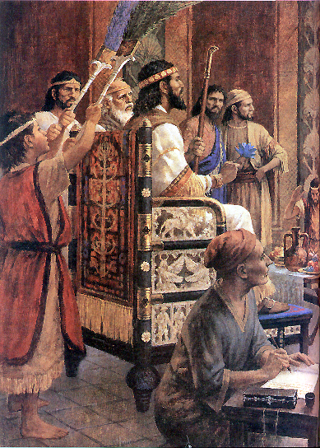
Daniel 10 - Angel of the Nations
v.1 In the 3rd year of Cyrus, king of Persia a message
was revealed to Daniel.. named Belteshazzar
Persian Monarch mentioned in:
Dan 1:21 “Until the first year of Cyrus..”
Dan 6:28 “In reign of Darius & of Cyrus”
Dan 10:1 “In the third year of Cyrus”
Date: Captives released in 536 BC.
In Cyrus’ 3rd yr it’s 533BC & Daniel nears 90 !
Critics in 1800’s said Isaiah must be fraud:
Isa 44:27 names Cyrus 200 yrs before birth
Isa 53 Said to be written 100’s yrs after Christ
Answer: Dead Sea Scrolls contain Isaiah written
100 BC. But hidden & undiscovered until 1947.

Slide 3
Daniel 10 - Angel of the Nations
v.2-3 In those days I, Daniel had been mourning
for three entire weeks... I did not eat any
tasty food, meat, wine..
10:12 He had set his heart on understanding
9:26-27 Prophecy of the coming
Destruction of Jerusalem AD 70
10:14 Understand what
will happen in latter days
Not eat tasty foot, meat or wine: (v.2) He has been
fasting. Water & unpleasant food might be allowed.

Slide 4
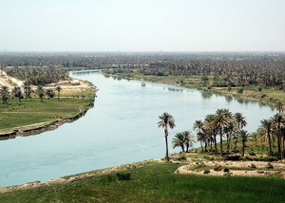
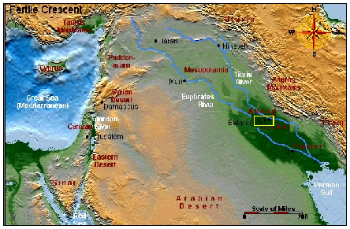
Daniel 10 - Angel of the Nations
v.4 On the 24th day of the first month while I was
on the bank of the great river... that is he Tigris
3 days after Feast of Unleavened Bread 15t^{h}-21st (Ex 12:18)
A previous vision was situated on the Ulai in Elam (Dan 8:2)
Tigris: flows over 1,000 miles SE from mountains of Turkey
to the Persian gulf.

Slide 5
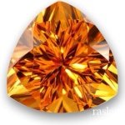
Daniel 10 - Angel of the Nations
v.5 I lifted up my eyes and there was a certain man..
Dressed in linen
Sanctity of clothing for
Angels (Ezek 9:2; Dan 12:6-7; Rev 15;6).
Belt of pure gold:
Interwoven (Rev 1:13).
v.6 His body was like beryl:
Topaz
Face had the appearance of lightning. Rev 1:14ª
Eyes were like flaming torches. Rev 1:14^{b}
Arms & feet like gleam of polished bronze Rev 1:15
Voice like the sound of a multitude. Rev 1:15^{b}

Slide 6
Daniel 10 - Angel of the Nations
Dan 10:9 I heard the sound of his words & as soon
as I heard the und of his words, I fell into a deep
sleep on my face, with my face to the ground.
10 Then behold, a hand touched
me and set me trembling on
my hands and knees.
Passing out in the
presence of a
heavenly beings.
(Dan 8:18; Rev 1:17)

Slide 7
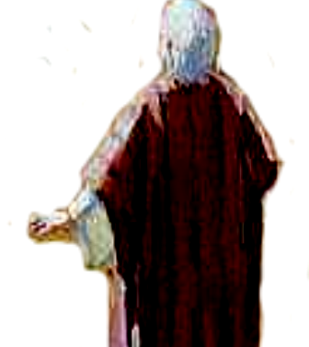
Daniel 10 - Angel of the Nations
Dan 10:12 Do not be afraid, Daniel, for from the
first day that you set your heart on understanding
this and on humbling yourself before your God,
your words were heard, and I have come
in response to your words.
Dan 10:11 Daniel, man of high esteem: High praise.
Dan 10:12 From the first day: God listened immediately!

Slide 8
Daniel 10 - Angel of the Nations
Dan 10:13 "But the prince of the kingdom of Persia was withstanding me for 21 days; then behold, Michael, one of the chief princes,
came to help me.”
The angel of darkness that represented the Persian world-power, withstood
the angel who was coming
to relieve Daniel, as the representative of God's people Israel. JFB

Slide 9
Daniel 10 - Angel of the Nations
Dan 10:14 "Now I have come to give you an understanding of what will happen to your
people in the latter days, for the vision
pertains to the days yet future."
Latter days - prior to fall of Jeru AD 70.
(Acts 2:16-17) Details of Chap 11 cover
Persia to the fall of Jerusalem.
v.16 Behold one resembling a human -- same
being as in v.5 except less startling form (Leupold)
Compare Daniel’s response in this verse.
Why isn’t this Jesus? He needed help (v.13)

Slide 10
Daniel 10 - Angel of the Nations
Dan 10:19 “And he said, "O man of high esteem, do not be afraid. Peace be with you; take courage and be courageous!" Now as soon as he spoke to me, I received strength and said, "May my lord speak, for you have strengthened me."
Josh 1:7 Only be strong
and very courageous
Certainly you’ve prayed v.2
You’re concerned for your people v.14
Ever have prayers that you wanted answered SOONER?

Slide 11
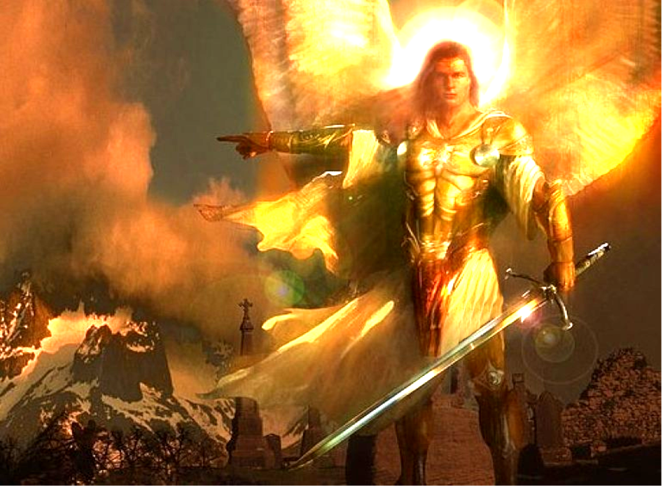
Daniel 10 - Angel of the Nations
Dan 10:20 I shall now return to fight against the prince of Persia; so I am
going forth, &
behold, the
prince of
Greece is
about to come.
Dan 10:21 Yet no one stands
firmly with me against these forces except Michael
your prince. (12:1)

