Slide 1
Phil 2:17-30
Being
Spiritual Warriors
Manly men &
Courageous Women
Notes:
I believe that manly men are essential for building healthy churches.
Manly men and courageous women are not ones who can bench press 400#.
They don’t flatten NFL running backs, quarter backs or linebakers.
Manly men and courageous women are ones who have a passion
for Christ and His church. Warriors can come in any size, shape, and style;
however, they all love the Lord and are serious about building God’s kingdom.

Slide 2

Phil 2:17 Even if I am being poured out as a
Drink Offering upon the sacrifice & service of
your faith, I rejoice and share my joy with you all.
Drink offerings accompanied ALL _{blood} sacrifices on the altar.
Unintentional Sin offering (Nu 22:24)
Twice daily lamb offerings (Nu 28:3, 7)
Sabbath day burnt offerings (Nu 28:9-10)
The Passover burnt offerings (Nu 28:16,24)
Pentecost Bulls, rams, goats offerings (Nu 28:26,31)
What Was Paul’s Attitude ?

Slide 3
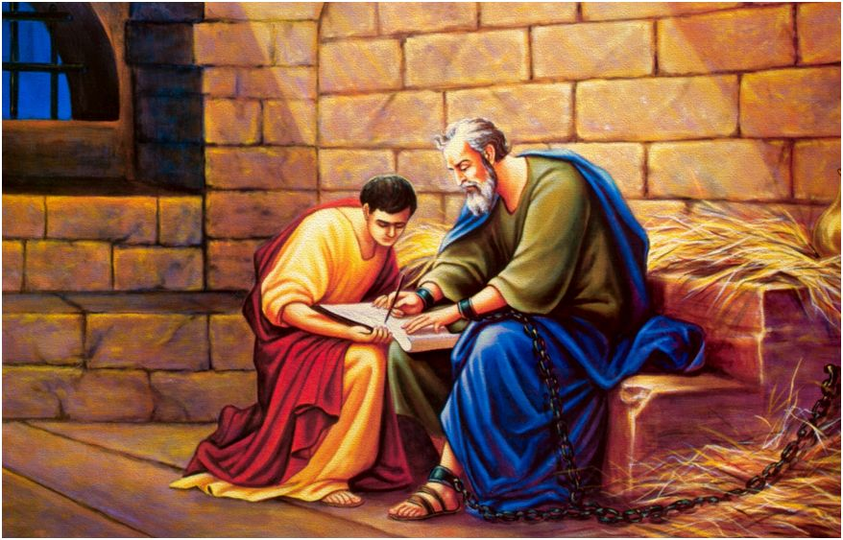
Phil 2:19 “But I hope in the Lord Jesus to send
Timothy to you shortly, so that I also may be
encouraged when I learn of your condition.”
Manly men and courageous women are needed
for building healthy churches.
Notes:
The use of the phrase “in the Lord” shows that Paul
doesn’t make decisions based his own wishes, but he
submits everything to the Lord’s His will.
Do you expect to find encouragement in knowing how believers are doing?
Or are you cynical, critical, and pessimistic?
A manly man, has the responsibility to lead their family in optimism.
If you are single, you also have a responsibility in the church to set an
example of confident hope and expectation for your church family.

Slide 4
Rome to Philippi – 6 weeks and 800 miles !
Cross Italy, cross Adriatic, cross Macedonia.
What do you DO and sacrifice – to show your interest in this congregation?
Notes:
Sail down Italian peninsula along Tyrrhenian Sea,
Cross the strait of Mesina.
Sail East across the Ionian sea south of the Adriatic.
Sail east of the Gulf of Corinth
Disembark and travel 17 miles east.
Board another ship or take the road heading north to Philippi.

Slide 5
Phil 2:20 I have no one who compares with him, who will care so sincerely for your welfare.
Complete
Jewish Bible
This arose from the fact that he had been with them when the church was founded there, and he felt a deeper interest in what related to them. (Barnes)
Timothy was chosen at Lystra (Acts 16:1); He was with Paul at Troas vision (v.8); He was at the riverbank
when Lydia was baptized at Philippi. (v.15); and
there several times after (Acts 18:5; 19:22; 20:1–4)
Notes:
Phil 2:20 “I have no one else of Kindred Spirit” lit equal-souled. Such total agreement.
Phil 2:21 They all seek after their own interests–
Later like Demas (2 Tim 4:10) loved this present world.
Share Paul’s desire bless others (see 1 Cor 10:33) Seeking their profit.
Manly men and courageous women focus on building up others—thereby building the churh.

Slide 6
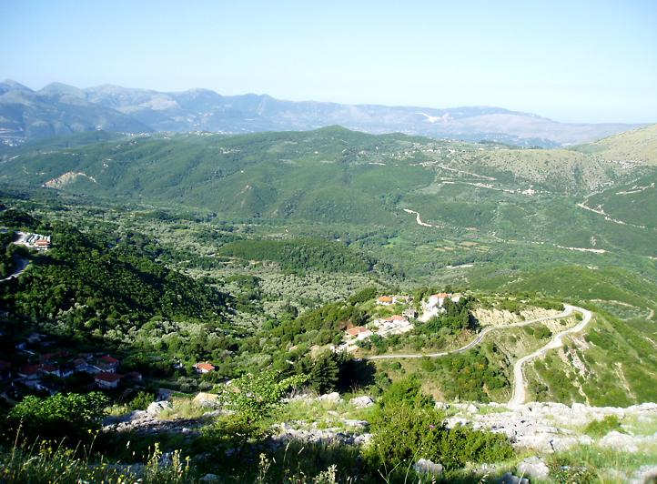
(2 Cor 11:26) I have been on frequent journeys,
in dangers from rivers, dangers from robbers.
Via Egnatia: Roman road
built 200 BC thru Macedonia.
Phil 2:21 For they all seek after their own interests, not those of Christ Jesus.
Are you ready to start
your journey?
Plan to be here EVERY night for our gospel meeting Sunday reg times. Mon – Fri 7:00pm May 21-26
Successful Personal Evangelism.

Slide 7
Christ-Centered Evangelism
Successful Personal Evangelism
How to reach the Lost for Christ
How to help the Church Grow
By world –travelled missionary Bob Buchanon
Sun Class 9:30am Foreign Evangelism.
Sunday AM 10:30am His Word Burns in my heart.
Sunday PM 5:00pm Whose Job is Evangelism?
Monday 7:00pm Getting Everyone Involved.
Tuesday 7:00pm Whole Church Growth.
Wednesday 7:00pm The Focus of Our Work.
Thursday 7:00pm Evangelistic Events.
Friday 7:00pm Obstacles to Evangelism.

Slide 8
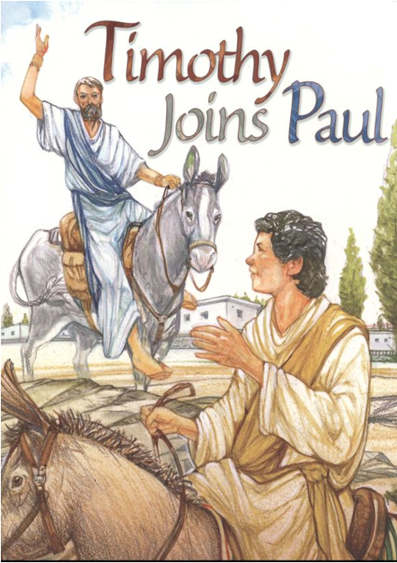
Phil 2:22 You know of Timothy’s proven worth that he served with me in the furtherance of the gospel
2Tim 1:5 Godly Heritage!
Faith dwelt first in grand-mother Lois & mother Eunice.
2 Tim 3:15 Early Training! From childhood known the sacred writings leads to salvation.
2Tim 1:2; 3:10 Strong Male-Role Model ! Followed my teaching, conduct, faith, love, perseverance…
2Tim 1:6-7 Admonition to Better Service! “Kindle afresh”
Notes:
Timothy has demonstrated his worthiness as a servant of Christ
and of Paul for more than ten years.
His name in Greek means “he honors God.” Tim is living up to his name.
He does not cave under pressure. Instead, he proves himself over time.
It has been said that people are like teabags...you never know how strong
they are until you drop them in hot water.
Are you a flash in the pan? Are you a one-hit wonder?
If so, recalibrate your spiritual life and commit for long haul service.
Men, what is your excuse?
One of the greatest gifts you can give your spouse and children is to take them to church.
If you want to be a manly man, you must--I repeat, MUST--show spiritual leadership in your home.
Pack your Bible and your family and take them to church.
Remember, you are the spiritual thermostat in the home.
Your spiritual involvement in the lives of your family members is critical.
Even if you’re not married or don’t have children, you can invest well in up and coming Young People.

Slide 9
Epaphroditus is a man whose name appears only twice in the New Testament (Phil 2:25; 4:18).
Brother (adelphos) indicates warm personal intimacy and friendship.
Fellow worker (sunergos). He’s a
workhorse doing whatever is asked of him.
Fellow soldier He fought shoulder-to -shoulder in Rome like soldiers’ battle ethic of standing side-by-side, dug in with shields locked solid, swords drawn.
Messenger (apostolos). He was one sent by Philippi.
Minister (leitourgos). Serving God, by serving others
Notes:
FELLOW WORKER: Bring money. Get food, reaching people for Paul
then bring them, possibly transcribing letters.
Who would call me a brother, a fellow worker, and a fellow soldier (2:25)?
Can other Christians honestly use these descriptions about me?
Who would I describe with these terms in my life?
Who has helped me grow spiritually?
Do I regularly express my deep love, respect, and appreciation for this person?
If not, will I do so today?
FELLOW SOLDIER: Epaphroditus is a battle-tested warrior.
MESSENGER: In Paul’s day prisoners were not cared for by the state,
but “necessities” for life (especially food) had to be supplied by friends or relatives.
MINISTER: He did not take the gospel to an unreached area.
He did not receive special revelation. He didn’t write a personal book in the Bible
All he did was deliver money to Paul and then look after him.
We must understand that to serve in some unnoticed, unrecognized place in the
body of Christ is as much the work of Christ as is preaching.

Slide 10
Phil 2:26 He was longing for you all & was
distressed because you had heard that he was sick.
Six weeks & 800 miles & he’s deathly sick.
Epaphroditus went first & took the letter.
Timothy is to follow soon. (Phil 2:19)
He became distressed [ademoneo] Louw
with implication of anguish. Same
word when Jesus came to the
Garden. (Mt 26:37; Mk 14:33)
27 Indeed he was sick to the point of death, but God had mercy on him.
Have I risked
my neck or reputation to share the good news with others?
Notes:
v30 RISKING HIS OWN LIFE:
BDAG s.v. paraboleuomai. is ONLY here in the NT,
but in extra biblical Greek the word was used of people
who spoke up for their friends at the risk of their own safety and security.
Several hundred years later—during the time of Emperor Constantine,
There arose societies of Christian men and women who called themselves
“The Parabolani,” meaning “ “the gamblers.” They ministered to the sick,
he imprisoned, and the outcasts.
They saw to it that martyrs received honorable burial.
Thus, from this word alone it is clear that Epaphroditus is no coward ,
but a courageous manly man willing to take enormous risks, ready to play
very high stakes in order to come to the aid of a person in need.

Slide 11
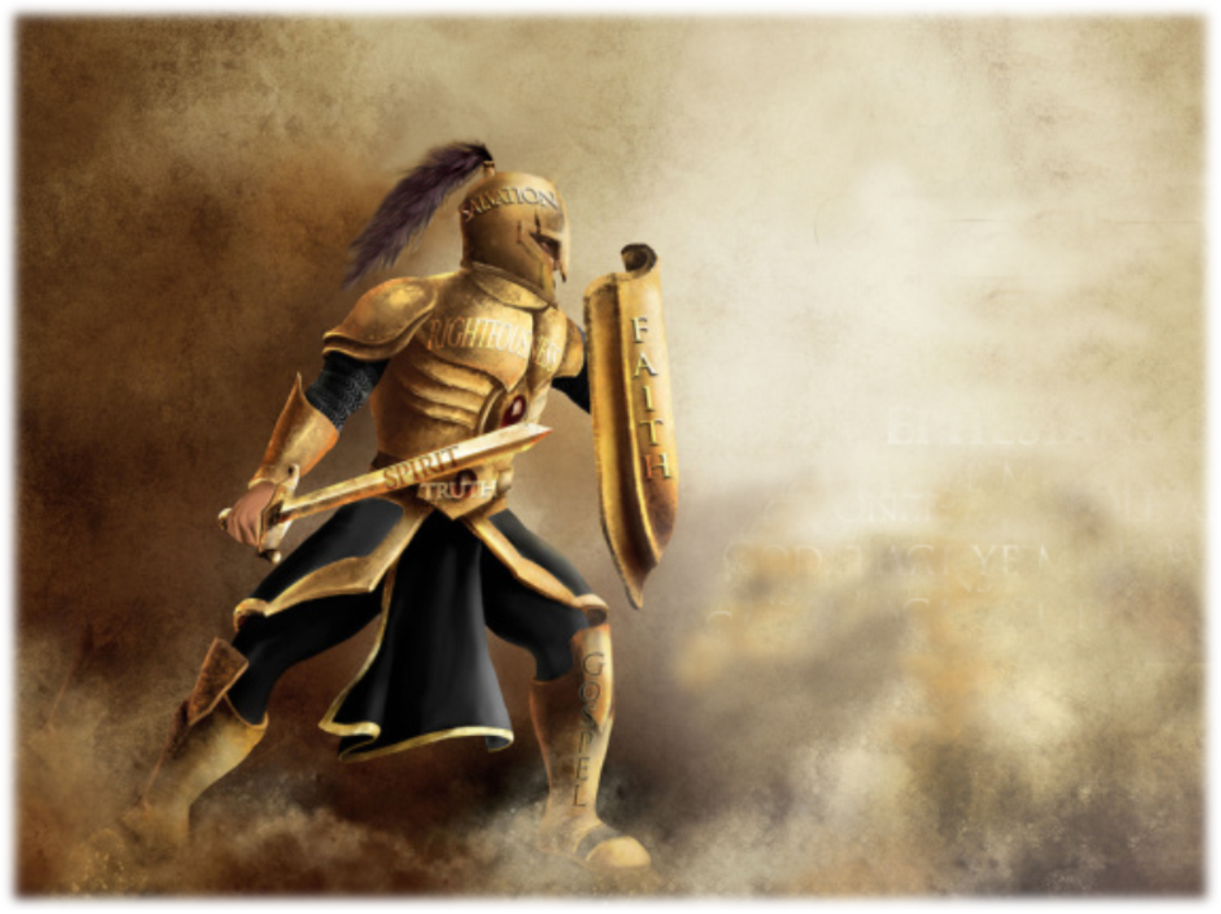
Phil 2:29
Therefore receive him in the Lord with all joy, and hold men like him
in high regard.
Notes:
The story is told of two inseparable friends who enlisted together, trained together,
shipped out together, and fought in the trenches together during World War I.
During an attack, one of the duo was critically wounded in a field filled with fire
and it was suicidal to try to reach hibarbed wire obstacles and, because of that,
as unable to crawl back to his foxhole.
The entire area was under enemy fire. Nevertheless, undaunted, his friend decided to give it a go.
Before he could get out of his own trench, his sergeant yanked him back and told him,
You’re crazy! It’s far too late. You can’t do him any good and you’ll only end up getting yourself killed.”
A few minutes later the officer turned his back, and instantly his mate went after his friend.
Shortly afterwards, he staggered back, mortally wounded, with his friend now dead in his arms.
The sergeant was both angry and deeply moved. “What a waste,” he blurted out.
“He’s dead, and you’re dying. It just wasn’t worth it.”
With almost his last breath, the dying soldier retorted: “Oh yes it was,
for when I got to him, the only thing he said was, “I knew you would come, Jim.”
The lesson is that Jim was there for his friend whatever the cost.
Like Jim, will you be there for at least one other man?
Undoubtedly, you can make a difference in at least one man’s life.
But I am confident that you can be used by God to transform the culture of your church
and touch people all over the world. All that is required is depending upon the Lord Jesus
to use you to be His change agent.
Will you step up today and become a manly man?
If you are already a manly man or a courageous woman,
will you ask God to take you to the next level of masculine ministry?
This church needs you. We are counting on you!

