Slide 1
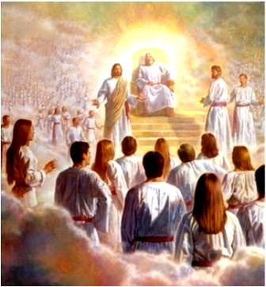
Does God Exist ?
Everything We DO is influenced by what we BELIEVE about..
The Father
The Son
Spirit
Bible
Is He Merciful? Sadistic? Or Mythical?
Is He Your LORD? A Liar? Or a Lunatic?
Is He Revealer? Breath? Beauty in nature?
Is it God Inspired? Folklore? Fake/psychotic?

Slide 2
DOES GOD EXIST ?
We are NOT going to argue for God from the Bible !
We call our first WITNESSES
The Most Fundamental laws of Physics 1st and 2 ^{nd} Laws of Thermodynamics …
The Demonstrate that the material Universe CANNOT BE ETERNAL !

Slide 3
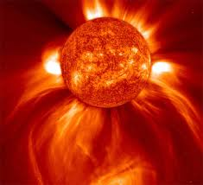
Evidence for God from Design
#1 Earth— Right kind of Galaxy: Too dense and all life dies by radiation, or gravitational pull.

Slide 4
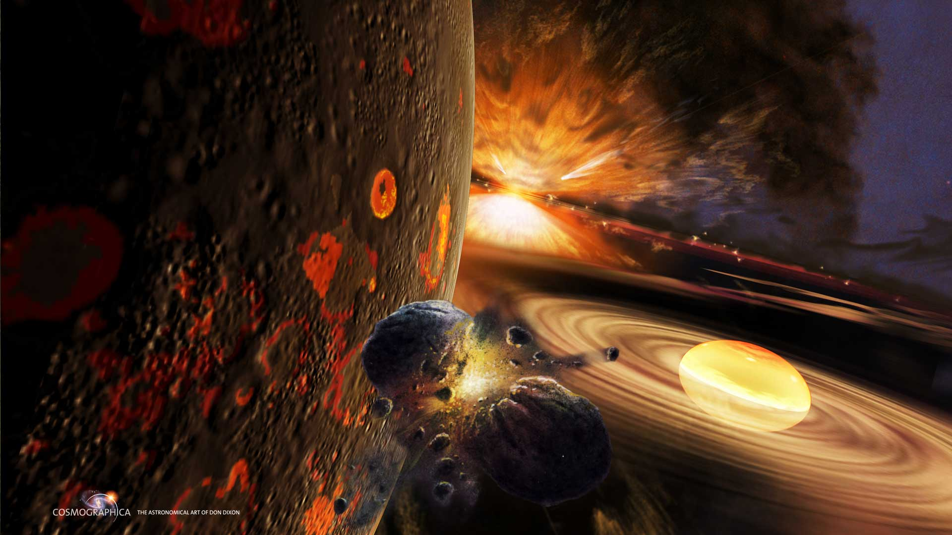
Evidence for God from Design
#2. Earth: Right place in Galaxy—too near the axis & there’s too many horrific events like Black Holes !

Slide 5
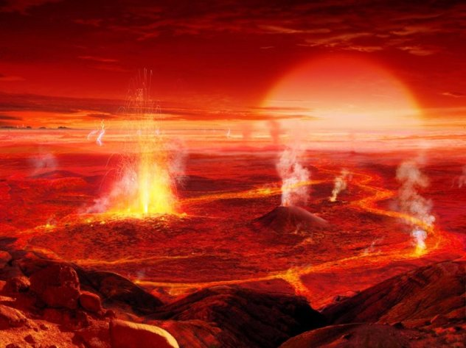
Evidence for God from Design
#3. Right kind of Star— for Earth: ½ hotter & all water is vaporized. ½ colder and all water is frozen.
Notes:
List Verse.com/ 10 Terrifying Planets You don’t want to visit
Near the center of our Galaxy you find seas made of compounds like crude oil and tar. The surface of the planet bubbles with foul smelling methane pits and black ooze. The weather forecast doesn’t look good either: it’s raining gasoline and asphalt
Neptune: Great Dark Sport> Earth-size hurricane, winds whip past at a staggering 1,500 miles per hour. That is more than double the speed of the sound barrier.
Pegasi-b, this gas giant is over 150 times as massive as earth and made mostly of hydrogen and helium. The problem is it roasts in the heat of its star at over 1800 degrees F. Such intense heat enables the iron composing the planet to be vaporized. As the iron vapor rises it forms iron vapor clouds, (like our water vapor). Then these clouds rain a relentless fury of molten iron down upon the planet.
Wasp 12b: Hottest planet yet found is so close to its sun that the temp is 4,000 f which is twice the temperature of lava! It incinerates everything biologic & twice heat to melt ROCK !
Pluto is so cold that its surface temperature is minus 380. Your body would freeze instantly at just minus 230 degree So bring a coat.

Slide 6
Evidence for God from Design
#4. Earth Right Spin on Axis.
Currently 1,000 MPH & 93 million miles from sun.
Faster — or slower rotation and we’d “cook” or “cook then freeze.”

Slide 7
Evidence for God from Design
#5. Right Earth Atmosphere— at 14# per Sq In.
Too THICK and it crushes all life.
Too THIN & meteors would burn up all life.

Slide 8
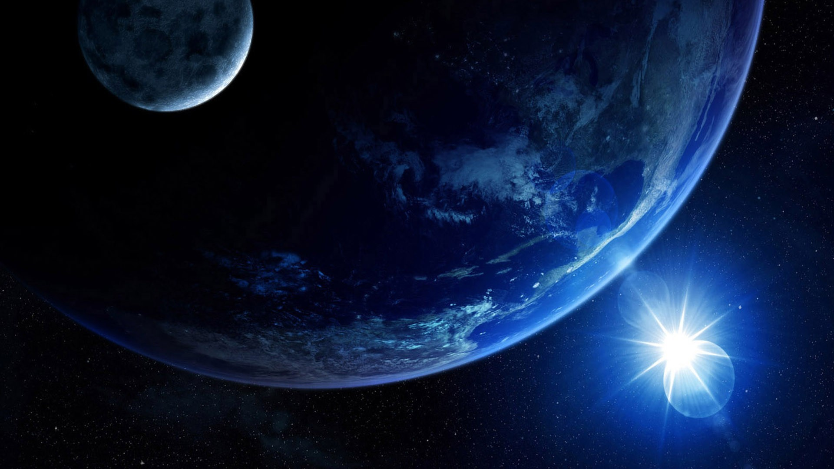
Evidence for God from Design
#6. Earth—Right Distance from moon—
If moon was 50,000 mi closer all continents would be submerged twice a day & eroded.

Slide 9
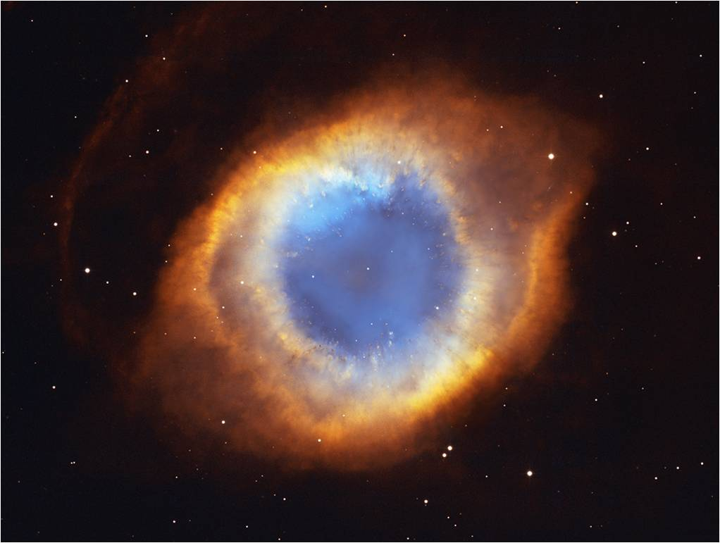
FACT: Heavens Declare the Glory of God
The Power of God is Seen
Rom 1:20 Since the creation of the world His invisible attributes: His Eternal power and Divine nature..
(Col 1:17) He is before all things & In Him all things consist.
have been clearly seen being under -stood through what has been made.
“The Eye of God Nebula.” Located in the constellation Aquarius. Spans 2.5 LY.

Slide 10
FACT: the wisdom of god
Isa 55:9 "For as the heavens are higher than the earth, So are My ways higher than your ways, and My thoughts than your thoughts.
One MIT Physicist said “There is NOT 1 thing in physics that I am absolutely sure of.” ¹
¹More than Meets the Eye: R.A. Swenson.
Jesus said: “I am THE Way, THE Truth, and THE Life, no one comes to the... (John 14:6)

Slide 11
FACT: God’s eternal power & Nature are seen
Rom 11:33 Oh , the Depth of the riches both of the Wisdom and Knowledge of God !
There are about 5 sextillion atoms in a drop of water. MadSci.org.
How Unsearchable are His judgments and Unfathomable His ways!
That is 5 followed by 21 zeros!
Million, Billion, Trillion, Quadrillion, Quintillion, 5 Sextillion
Take every person on earth, counting at 1 atom per sec = 20,000 years to count the atoms in a single drop of water. R.A. Swenson More Than Meets the Eye ; p.103

Slide 12
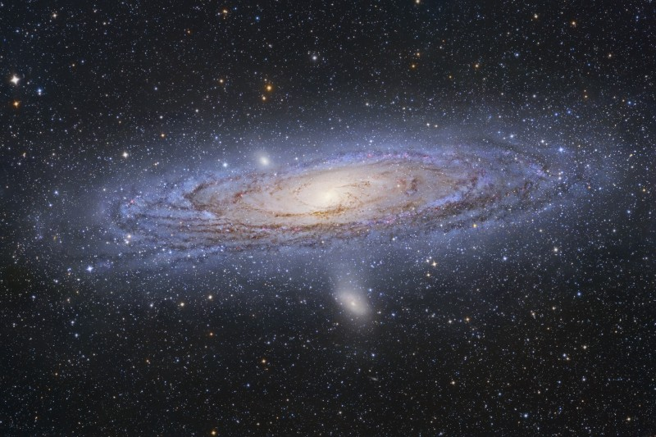
Fact: God’s eternal power & Nature are seen
Ps 8:3 When I consider Your heavens, the work of Your fingers, The moon and the stars, which You have ordained…
v4 What is man, that You take thought of him?
It is estimated that there are 100 Billion Galaxies in Universe. We can only see a fraction of them so true extent is unknown. Yet each Galaxy is estimated to have 200 – 400 Billion Stars !

Slide 13
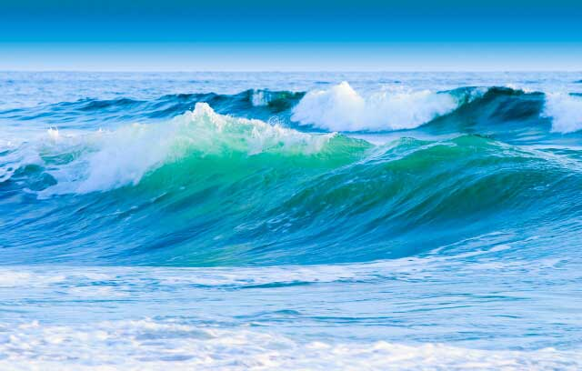
Fact: God’s eternal power & Nature are seen
How much Energy did God create? E = mc ²
“E” Energy = “M” Mass x “C ² ” Constant Speed of Light (186,000 mi sec) squared! This Formula suggests that a small amount of matter has a HUGE amount of energy.
One quart of water is about 2lb and & if all its energy were released at once, it has equi-valent to about 10 Million gallons gasoline.
God created 100 Billion Galaxies… Man Created ZERO.. Not one Atom !

Slide 14
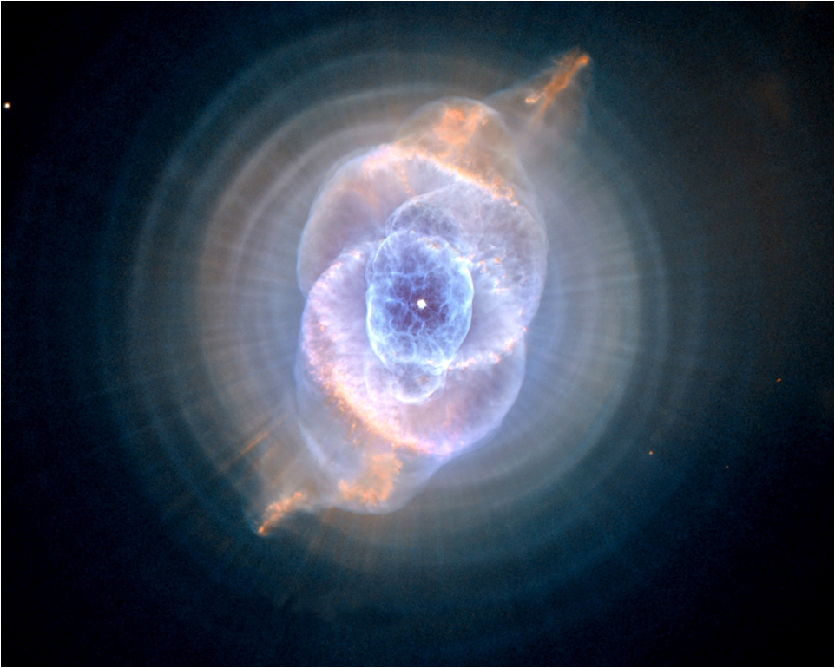
Fact: God’s eternal power & Nature are seen
God is POWERFUL at a level beyond human comprehension… and we can connect to that power!
(Eph 1:18-19) Might know what is … Richness of the glory in the inheritance in the saints and the sur-passing Greatness of His POWER to us who believe.
(Eph 3:20) Now to Him who is able to do exceeding abundantly beyond all that we ask or think, accord-ing to the POWER that works within us.
The Cat’s Eye Nebula—NGC 6543, in the ‘Dragon’ Constellation, 3,300 LY away.

Slide 15
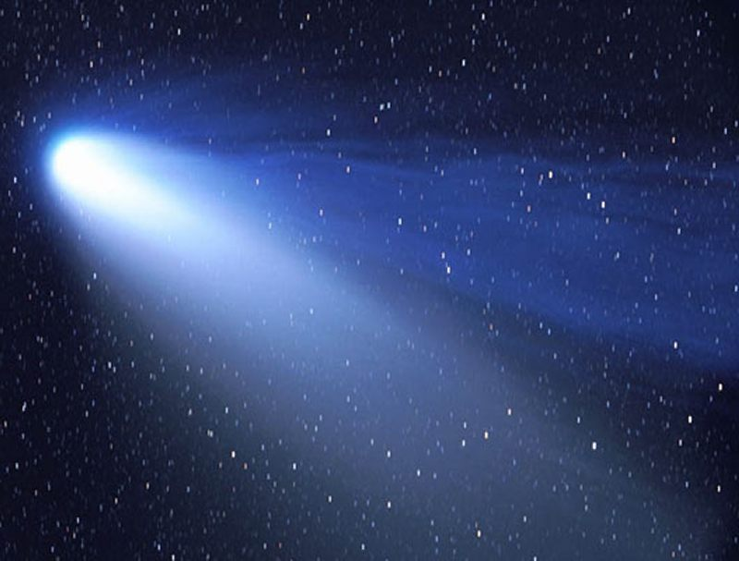
God’s eternal power & Nature are seen
Photons are tiny bundles of light¹ with zero mass yet traveling at 186,000 miles per second.
1 John 1:5 God is light, and in Him there is no darkness at all.
⁷ But if we walk in the light as He Himself is in the light, we have fellowship with one another, and the blood of Jesus His Son cleanses us from all sin.
Notes:
¹ Or other forms of electro-magnetic radiation such as Radio & TV with long wave length; Microwaves & Ultra-violet light with very short wave length; or Visible light with medium wave length.
But all are made up of Photons traveling at 186,000 miles per second

Slide 16
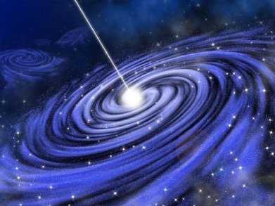
FACT: God’s eternal power & Nature are seen
Cool Facts about Light
Speed of light 186,000 mi per sec. or 671,000,000 MPH, which is just under 700 million mph.
Pretty zingy in traffic !
Einstein says that the Speed of light is Constant for all observers (Toward it or Away) ! That’s “Counter-Intuitive”! Yep!
And the FASTER you approach the speed of light, the SLOWER Time goes until it essentially stands still.
(2 Pet 3:8) One day is with the Lord as 1,000 years and… (Time is irrelevant)

Slide 17
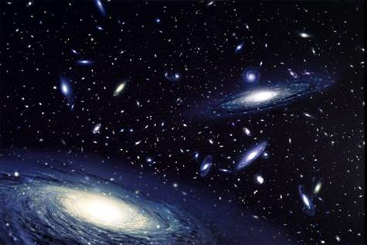
FACT: God’s eternal Nature & power are seen
“Whenever man tries to probe into the Universe’s dimension of SPACE, he will be confronted with INFINITY !”
“Whenever man tries to probe into the Universe’s dimension of TIME, he will be confronted with ETERNITY !”
Whenever man tries to probe into the Universe’s dimension of MATTER, he will be confronted with the fact that there are smaller and smaller particles and NO SMALLEST PARTICLE! Gerhard Staguhn
God is Unfathomable. He manipulates TIME as it suits Him. And the measure of His love for you is seen on Calvary ! (John 3:16)

