Slide 1

Unity and Eating
in the Building

Slide 2
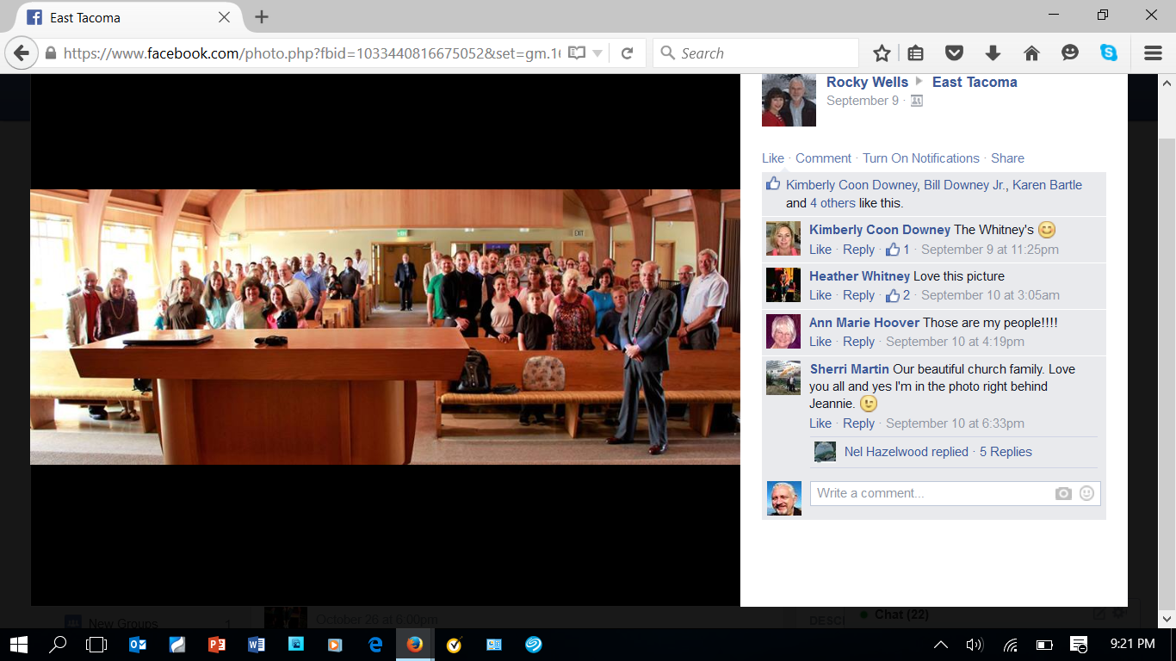
Unity
1 Tim 3:15 The FAMILY of God is the CHURCH
of the living God. NIRV

Slide 3
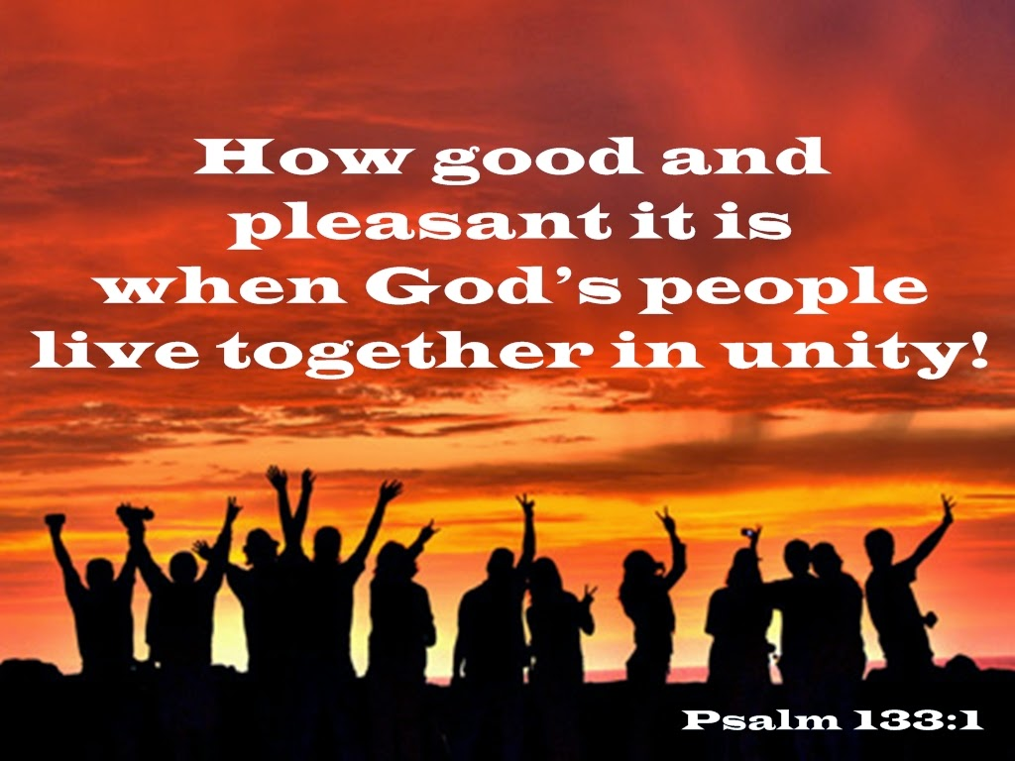
Blessing of Unity

Slide 4
Prayer for Unity
John 17:22 They may be ONE as We are One; v.23 I in them and YOU in Me. May they be brought to complete unity. NIV

Slide 5


100’s of Questions Church Could Ask
How many classes a week 2 OR 12?
What times to meet am/pm?
Songs to sing?
Length of sermons?
Preachers to support?
Elder’s tenure: 2 yrs or Life?
Buy or Rent a Building?
Crosses & stained glass?
What Uses of the Building?
Use Bible pics or not?
1 Pet 4:11 Speak as the Oracles of God !
Notes:
Uses of the church building? (And still be unified)
1. Promotion of POLITICAL groups (Republican, Democrat, Tea Party, Socialist? Communist? Independent?)
2. Weddings & Celebrations for ANYBODY (Regardless if Buddhist/Hindu or GENDER)—MONEY MAKER???
3. Rent to Lion’s or Kiwanis club (for Civic activities)—Nothing religious but DO good things for kids.
4. Rent to AA GROUPS, or Sylvan learning center? (Good for community & make more money $$$)
5. Recreation: SEA HAWKS & Brauts after church—on a BIG SCREEN?—Invite neighborhood >> Call IT Evangelism??
6. How about a RACUET BALL court? (Bible mentions exercise is a little benefit)—maybe a sauna to relax ????
7. SELF DEFENSE and Tai Kwan Do classes FOR CHRISTIANS?
8. Open DAY CARE Center? (Helps parents, Teaches kids, Make jobs for Christians, Make money for group)
9. How about POTLUCKS, BIRTHDAYS, ANNIVERSARY, GRADUATION dinners in the building???

Slide 6

What’s Bible Authority ?
Not Feelings (Prov 28:26) A Fool !
Not Majority (Mat 7:13) Often wrong !
Not Conscience (Acts 23:1f) What I believe!
Not Man’s wisdom (1 Cor 3:19) Foolish !
Not Leader (Mat 15:9) Precept of men !
2 Tim 3:16 “All Scripture is inspired by God
and profitable for teaching, for reproof, for correction, for training in righteousness;
v17 that the man of God may be adequate, equipped for Every Good Work.”

Slide 7
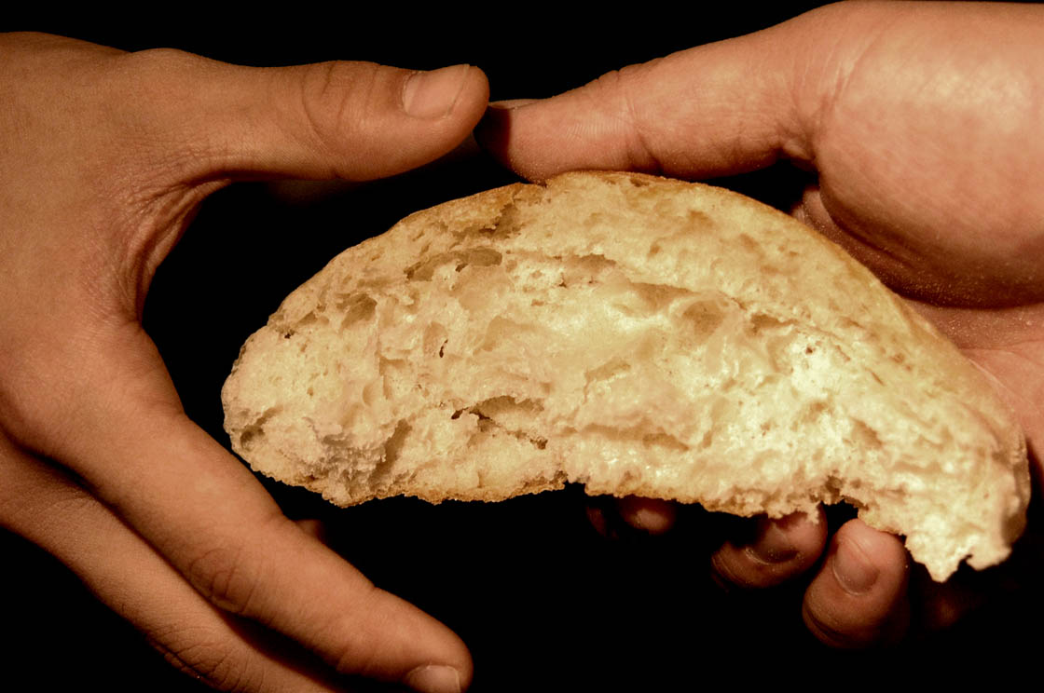
What are Love Feasts? Jude 12

Slide 8
Only NT Occurrence: (Jude 12) “These men are those who are hidden reefs in your love feasts when they feast with you without fear, caring for themselves; clouds without water… trees without fruit, doubly dead, uprooted.”

Slide 9
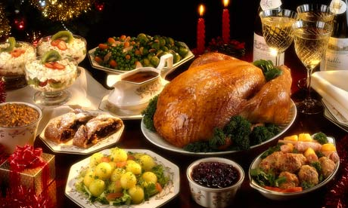
Where Did Saints Eat the “Love Feast” ?
Acts 2:46 “Breaking bread from house to
house taking their meals with gladness ...”

Slide 10
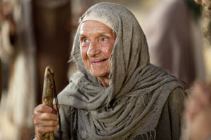
What was the Purpose of the Love Feast” ?
Christian Charity, Benevolence
James 2:15 “If a brother or sister is … in need”
“The purpose of the love feast was to
share God's provisions with the needy.”
Nelson’s Illustrated Bible Dictionary.
“A common table at which the wants
of the poor were supplied out of the
abundance of the rich.” ISBE
“The sharing of food by the wealthier
with the poorer was an important means
of charity.” Early Christians Speak, p 129.

Slide 11
When was the “Love Feast” Held ?
“The Roman governor Pliny places the Christian gathering for a common meal at a separate time from their ‘stated’
religious assemblies.”
Early Christians Speak p.127.
Pliny’s Letters; Book 10.96, addressed to Emperor Trajan
“It occurred in the late afternoon or early evening, the time of the principle meal of
the day.” Early Christians speak, p.129

Slide 12
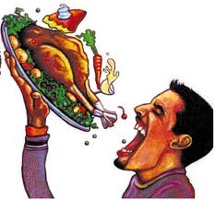
Abuse of the “Love Feast”
“The meal known as the love feast continued for several centuries. However, at times it became merely …a lavish banquet for the wealthy.”
Nelson's Illustrated Bible Dictionary
(1Cor 11:20) “In your eating each one takes his own supper first, one is hungry another is drunk.”
“It was a time when the poorer believers could enjoy a decent meal because of the generosity of the Christians who were better off economically. But the apostates only used the "love feast" as a
time for displaying their wealth.” —BEC.
(1 Cor 11:22) “Do you not have houses in which to eat and drink? Or do you despise the church of God, and shame those who have nothing?”

Slide 13
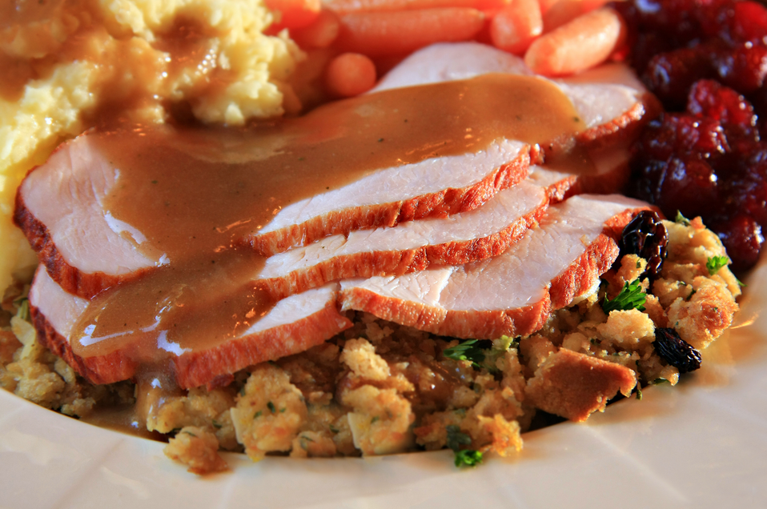
The “Love Feast” Abandoned.
“ Freemen despised the slave class, going ahead with the meal before the latter had opportunity to arrive .. The wealthy scorned the poor, feasting to the point of gluttony while the latter went hungry (1Cor.11: 21-22).” Zondervan Pictorial Bible
“After much controversy in the church, it was finally abolished at the end of the seventh century.” Nelson's Illustrated Bible Dictionary
This benevolent meal was NEVER an apostolic command, but simply one way to help
feed poor Christians.

Slide 14
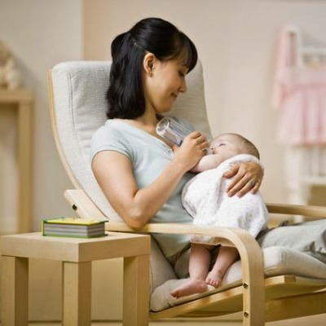
Most Churches Eat in the Building— Why ?
A Nursery for Moms to feed their babies during worship.
Ideally there is a monitor to see the lesson presented
and a speaker with
volume control to hear it.
The purpose isn’t recreation—but worship.

Slide 15
Most Churches Eat in the Building— Why ?
Christians eating lunch
to create, maintain,
repair their place to worship.
(Heb 10:25)

Slide 16
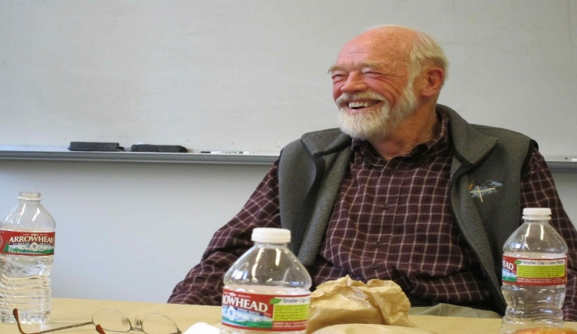
Most Churches Eat in the Building— Why ?
Preacher, Teacher
preparing
to edify.
Acts 20:7, 11 “When he [Paul] had gone back up, and had broken the bread and eaten, he talked with them a long while, until daybreak, and so departed.”
Paul alone is mentioned as eating, late night.

Slide 17
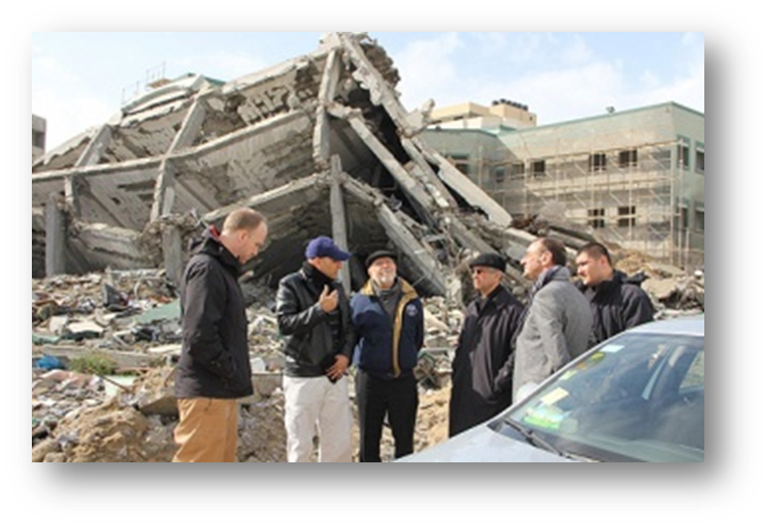
Might Eat in the Building— Why ?
Providing
Benevolence in
an emergency
Matt 9:13 "But go and learn what this means, 'I desire compassion, & not sacrifice”

Slide 18

Saints Eat in the Church Building— But Why ?
Kids EAT cheerios, candy in church, or diabetic needs something to keep
blood sugar at the
right level.
This isn’t done for recreation
but to help kids and adults stay in worship.
It’s NOT Doughnuts, cake and Starbucks coffee ... just for fun. (See Rom 14:17)

Slide 19
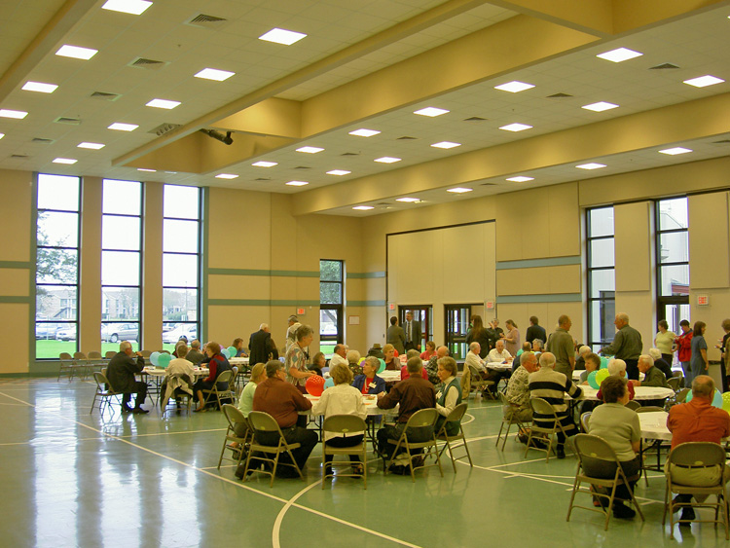
Saints Eat in the Church Building— But Why ?
A Gymnasium / Fellowship Hall is generally NOT
intended as Charity for Needy saints! (Rom 15:26)
It probably wasn’t built as provision
for Destitute Widows. (Acts 6:1)
John 6:26 “Truly, I say to you, you seek Me, not because you saw signs, but because
you ate of the loaves, and were filled.

Slide 20
Are Church - Sponsored Social Meals Biblical Fellowship ?
Analysis: Bible “Fellowship” KOINONIA is Never Denotes social / recreational – ALWAYS spiritual activities.
(1 Cor 1:9) “Fellowship with Son”
(1 Cor 10:16) “Share blood of Christ”
(Gal 2:9) “fellowship [to] go to the gentiles.”
(1 John 1:3) “Our fellowship is with the Father.”
(Philemon 6) “the fellowship of your faith.”
(Philip 3:10) “The fellowship of His sufferings.”
(Philip 2:1) “If there is any fellowship of the Spirit.”
(Philip 1:5) “Your participation in the gospel.”

Slide 21
For Unity We act in Love
1 Cor 10:23 “All things are lawful, but not
l things are profitable. All things are lawful, but not all things edify.
Col 3:13 “Bearing with one another, and forgiving each other…”
v14 And beyond all these things put on LOVE , which is the perfect BOND OF UNITY.

