Slide 1
We’ve Covered: Scientific evidence for God
The Evidence for the Bible
Historical evidence for Christ
The Need for Salvation in Christ for 1,000,000 sins ! (Rom 6:23)
Now: Need for Bible Authority

Slide 2
Bible Authority
GOD Has Inherent Authority (Gen 1:1)
Jesus Has All Authority (Mat 28:18)
Apostles
Have Delegated authority (John 20:21; 13:20)
Apostles & Prophets Wrote it.
Spirit Inspired it (John 16:13; 14:26)
You can understand it (Eph 3:3-4)
No One Must Change it. (Rev 22:18-19; Gal 1:6-9)
We’re Judged by it. (John 12:48)
Do You Accept it ? _________________________

Slide 3
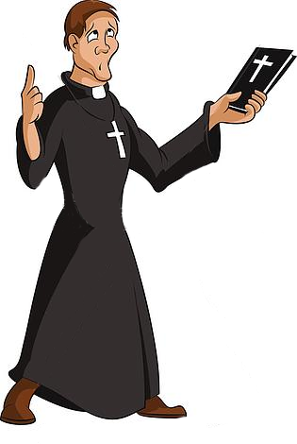
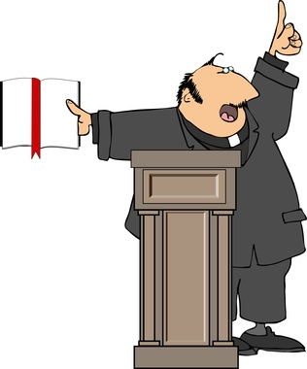
Identifying the NT Church
WHAT DOESN’T WORK
No use asking preachers– They all say “I’m Right!”
Pentecostal
Catholic
Baptist
Lutheran

Slide 4
Identifying the NT Church
WHAT DOESN’T WORK
Just scrolling– thru the Phonebook !
Some say there’s 217 denominations in USA.
Some say there’s 1,584 religious organizations in US & Canada, most professing Christianity.
Checking out just one per year takes you… ???
According to some estimates there are 4,200 religions in the world.

Slide 5
Police Seek Identity of Shooter
4 Witnesses say:
Suspect used revolver.
Wore red bandana.
1 Blue eye left side.
Patch over right eye.
Gold tooth, left side.
Two tattoos left arm: 1 Anchor, 1 Heart.
Leg missing at L. knee.
Weight ca. 300 pounds.
Wallet found with suspects’
name, age, and picture!

Slide 6
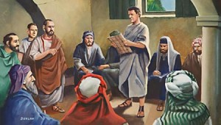
Identifying the NT Church
A New Testament Church Existed:
Jesus would build His church (Mt 16:18)
It existed in the 1st Century (Acts 5:11)
There was just ONE ! (Eph 4:4) (Eph 1:22-23) (Col 1:18)

Slide 7
Identifying the NT Church
Let’s Get the Traits of the Lord’s Church in the Bible, and see if we can find a church today that measures up.
The Name of the Church: (Rom 16:16) The Churches of Christ.
(Eph 4:12) The Body of Christ.
(1 Cor 1:2) The Church of God.
(1 Tim 3:15) The Church of the living God.
Are these names in the Bible: Baptist? Lutheran?
Episcopal? Adventist? Foursquare? Pentecostal?

Slide 8
Identifying the NT Church
Let’s See What Religious Leaders Said:
Charles Spurgeon—one of the greatest Baptist preachers.
“I say of the Baptist name, let it perish, but let Christ’s name last forever. I look forward with pleasure, to the day when there will not be a Baptist living. I hope they will soon be gone. I hope the Baptist name will soon perish; but let Christ’s name endure forever.” Spurgeon Memorial Library, vol. 1 p.168.

Slide 9
Identifying the NT Church
“I pray you to leave my name alone, and call not yourselves Lutherans, but Christians. Who is Luther? My doctrine is not mine. I have not been crucified for anyone. St Paul would not let any call themselves after Paul, nor of Peter, but of Christ.
Martin Luther—
How then does it befit me, a miserable bag of dust and ashes, to give my name to the children of God? Cease, my dear friends, to cling to these party names and distinctions: away with all; and let us call ourselves only Christians after him from whom our doctrine comes.” Life of Luther, by Stork 1 p.289.

Slide 10
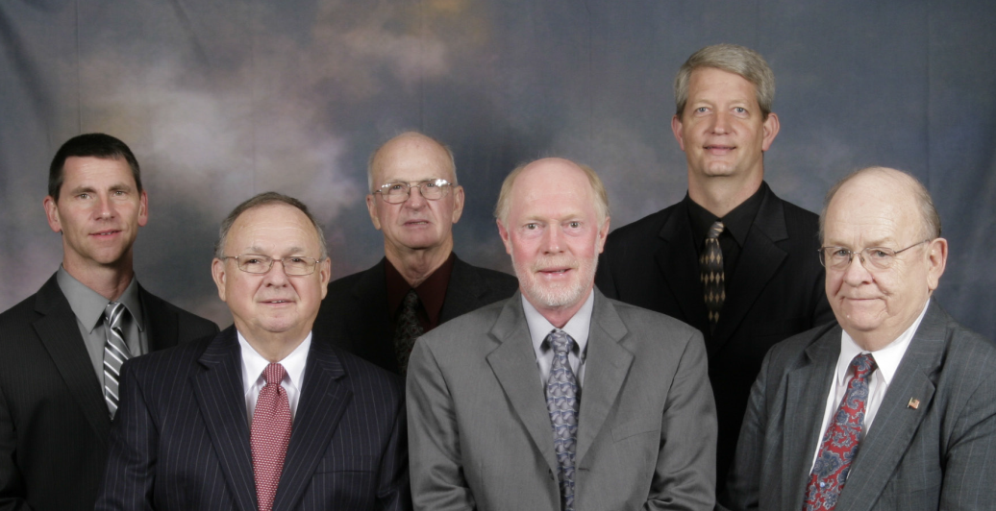
Identifying the NT Church
Church Organization: (Phil 1:1) Elders, Deacons & Saints.
Elders (1 Tim 3:1-7)
Deacons (1 Tim 3:8-12)
Are these names in the Bible: Pope? Archbishops? Cardinals? Priests of Melchizedek? Regional Superintendant? National Headquarters?

Slide 11
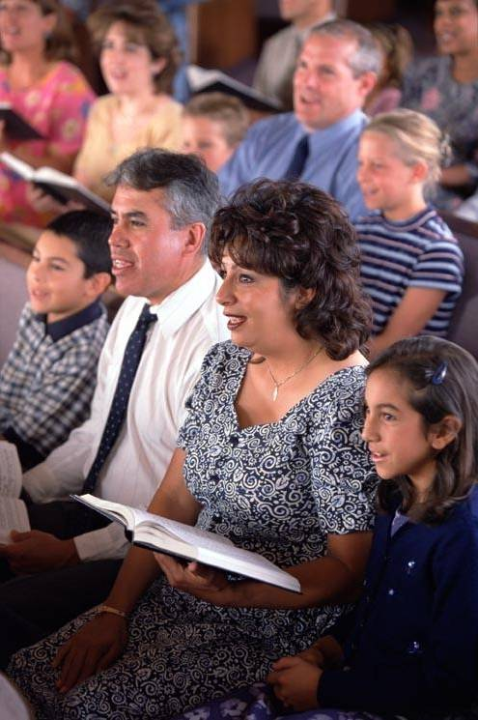
Identifying the NT Church
Worship by the Church
1. Singing, a cappella (Eph 5:19; Col 3:16)
2. Lord’s Supper (1 Cor 11:23-26) Weekly (Acts 20:7a)
3. Prayer (Acts 12:5b; 1 Tim 2:1-2)
4. Giving, not tithing (2 Cor 9:7; 1 Cor 16:2)
5. Preaching God’s Word (2 Tim 4:2) Not Man’s Opinion ! (Mat 15:9)

Slide 12
Identifying the NT Church
Plan of Salvation:
1. Believe (John 3:16; 8:24)
2. Repent (Acts 3:19; 2 Cor 7:9-10)
3. Confess (Rom 10:9-10; Mat 10:32-32)
4. Be Baptized (Acts 2:38; 22:16; 1 Pet 3:21)

Slide 13
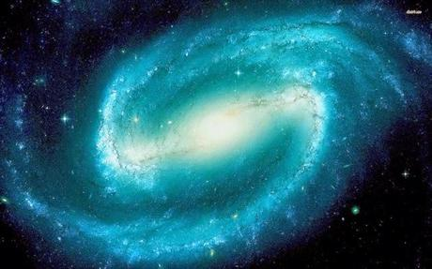
ARE YOU READY ?

