Slide 1

The Spirit of Giving
Term “SPIRIT” is also used for
disposition, propensity, or willingness of a person.”
spirit of justice (Isa 28:6);
spirit of wisdom (Ex 28:3);
spirit of gentleness (Gal 6:1)
Givers’ traits: Driven to meet the needs of others.
Care deeply about others. Generous, Supportive, Loving, encouraging, Motivational, Inspirational,
Selfless, Optimistic; Committed and Loyal.

Slide 2

The Spirit of Giving
We may give hope,
encouragement,
loyalty, gifts,
wise counsel,
& life itself.
Rom 12:8 “If we can give, we should be generous.. If we are good to others, we should do it cheerfully.” CEV
Let’s look at the example of Biblical Givers.
Consider: are We “Givers” or “Takers”?

Slide 3
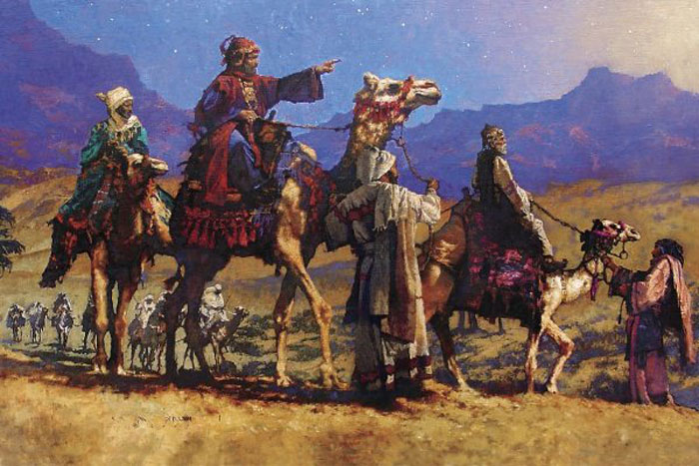
Wise Men Gave Gifts
Planning
Sacrifice
Expense
Time
Mat 2:2 Magi seek one born King of Jews!
Perhaps learned of Jesus from Messianic
Jews remaining in Babylon. (Mic 5:2)
Mat 2:11 The Magi bring gifts 1,000 miles.

Slide 4
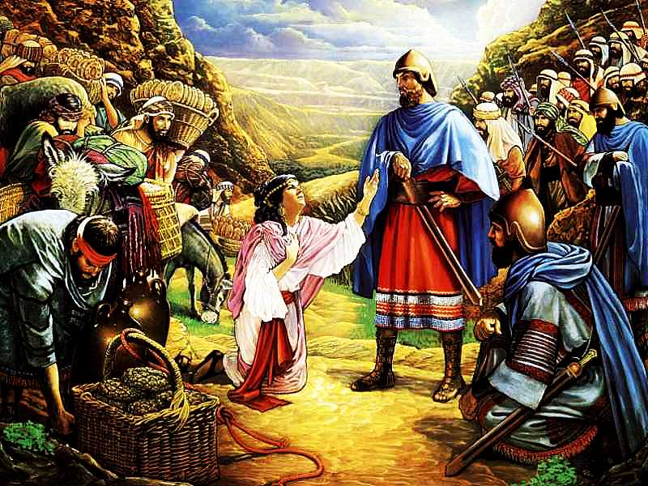
Abigail Gave Food
Intelligent &
Beautiful
1 Sam 25:3
1 Sam 25:18 Brought 5 prepared sheep; 200 loaves, 200 fig cakes.
1 Sam 25:23-24 Her gifts, her
submissiveness & humble words saved lives.

Slide 5
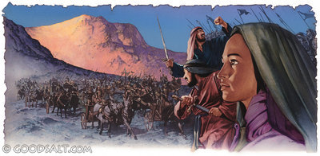
Deborah Gave Courage
Judg 4:4 a Wife
v.4 a Prophetess
v.4 a Judge in Israel
Judg 4:10, 14 Heart of a warrior “Arise!”
Judg 5:7 a Mother to Israel. “She watched
over her people with maternal care.” (Keil)
Mature, Godly women give Courage & Counsel

Slide 6
Barnabas Gave Encouragement
Acts 4:36 Nickname: Son of Encouragement
Acts 4:37 Sold land and gave it for poor.
Acts 9:27 Stood up for Paul at Jerusalem.
Acts 15:39 Saw good in John Mark!

Slide 7
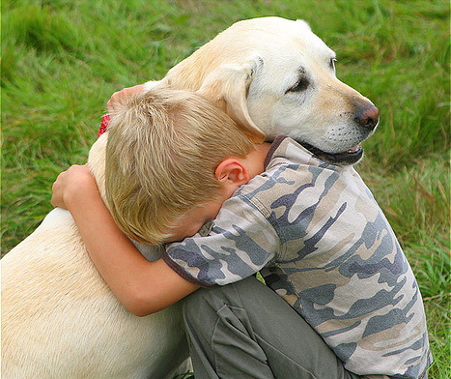
How to Encourage
#1 Remember people are hurting
more than you know, more than they show.
#2 It takes more availability than ability.
It takes more heart & love than skill.
#3 Be patient. Listen. Encouragement
is helping them to take the next step.

Slide 8

Sharing Your Gifts
Always be generous with your encouraging words. They help
others to be the best they can be.

Slide 9
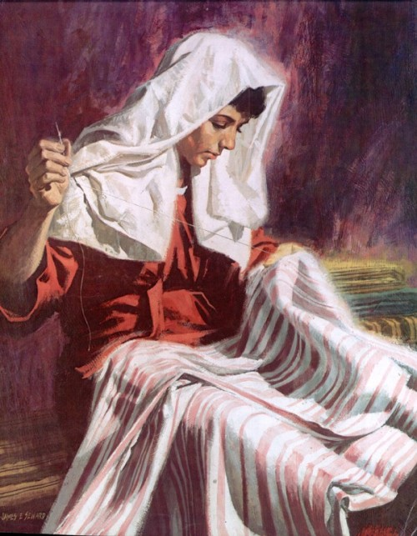
Tabitha Gave Kindness
Acts 9:36a Gazelle:
Believer in coastal
port of Joppa.
Acts 9:36 “Abounding with deeds of kindness and charity, which she continually did.”
v39 “Widows cried.. showing the robes and clothing she made.”
Takes planning, expense, sacrifice, time, love.

Slide 10
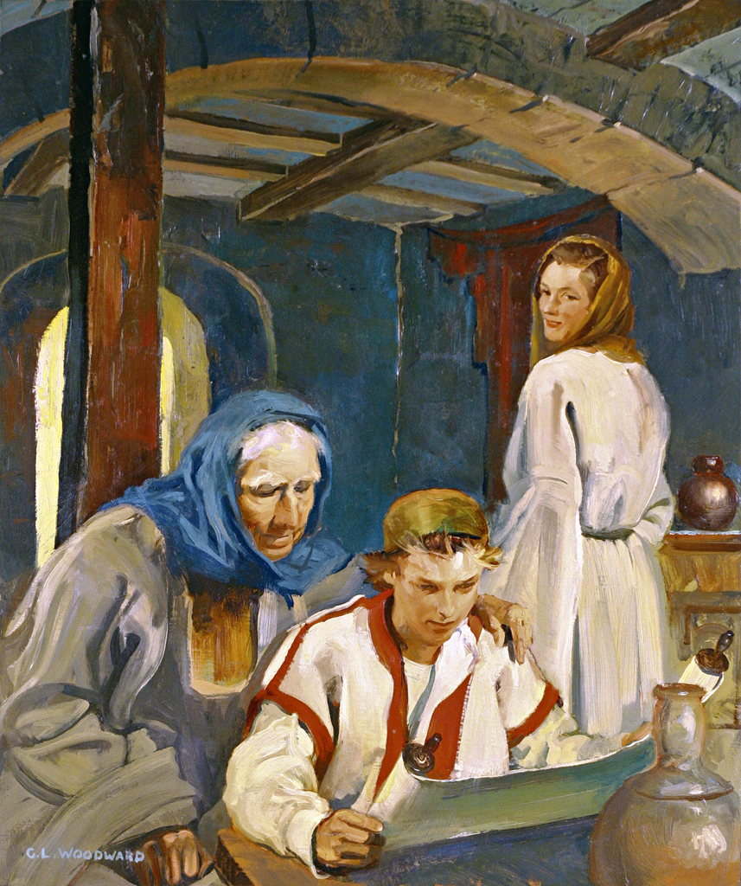
Lois Shared Faith
2 Tim 1:5 “The sincere faith.. which first dwelt in your grandmother Lois, and your mother Eunice.”
“It seems probable that she was the first of the family who was converted.” Barnes
2 Tim 3:15 “From childhood you have known the sacred writings which are able to give you the wisdom that leads to salvation through faith.”

Slide 11
Lydia Gave Hospitality
Acts 16:12 In Philippi Paul met Lydia v.14, a “seller of purple fabrics
and worshipper
of God.”
She, then her household
were baptized v.15a
She persuaded the evangelist group v.15b
<Paul, Silas, Timothy & Luke> to stay in her house. Joyously learning, yet with sacrifice.

Slide 12
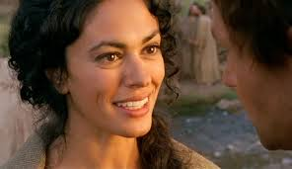
Magdalene Shared Finances
Tuff beginning: Lk 8:2
Seven demons cast out.
Luke 8:3 Mary Magdalene
(and many others) were “contributing to their sup-
port out of their private means.”
She was at the trials, at the crucifixion, at Jesus burial & first to see His resurrection !
Thankfulness, Sacrifice, Devotion, Love.

Slide 13
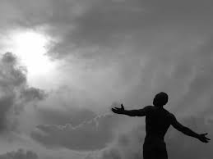
Christians Gave Themselves
2 Cor 8:5 Macedonians “first gave themselves
to the Lord & to us .”
They first made an entire dedication of themselves and all that they had to the Lord.
They kept nothing back.
They felt that all they had was His.

Slide 14
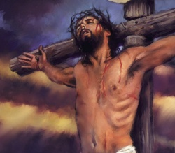
John 3:16
“God so loved the world..
Jesus gave
His Life
John 10:17f
“I lay down
My life..”
that He gave His only begotten
Son.”
John 15:13 “Greater love has no one than this, that one lay down his life
for his friends.”

Slide 15
Givers’ traits: Driven to meet the needs of others.
Care deeply about others. Generous, Supportive, Loving, encouraging, Motivational, Inspirational,
Selfless, Optimistic; Committed and Loyal.

