Slide 1
Your Goals – Your Life
“Every great
project begins
with Believing
it is Possible.”
“Then you
take the
1st step.”
Ann

Slide 2
Your Goals – Your Life
People surrender their dreams for:
Happiness
For Health
For peace
Sobriety
Greatness
For family
For finance
For influence
Mark 9:23
“All things are
possible to him
who believes."
v.24 “I do believe;
help my unbelief."
Prov 23:7 “As he thinks in himself
so is he.”

Slide 3
Are We Really Trapped?
John 8:32 “You shall know the truth,
and the truth shall make you free. "
“I no longer think of myself as a cardiac patient—but as an athlete in training.”
Ann Hoover

Slide 4
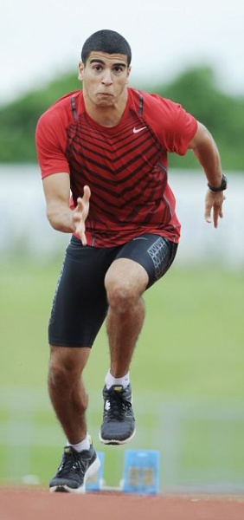
I ask: What is an Athlete?
Merriam Webster
ATHLETE: “A person who is trained or skilled in exercises, sports, or games requiring physical strength, agility,
or stamina.”
1 Cor 9:25 “Everyone who competes in the games exercises self-control
in all things.“

Slide 5
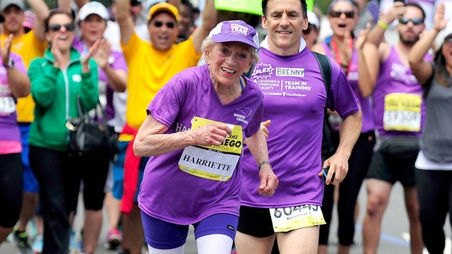
Harriet Thompson signed up for the
San Diego Marathon to benefit
leukemia patients.
She completed the race in 7 hours & 24 min
by combining running with walking the up -hill places—as oldest female runner: age 92 !

Slide 6

Be Transformed by the Renewing
of your Mind (Rom 12:1-2)
Phil 4:13 This Year
In Christ I can be:
Stronger
Better
Wiser
More Joyful
More Faithful
More Positive
More Disciplined
More Victorious
More of Everything Good

Slide 7


Slide 8

1. Define Your Goal
Jesus Did Luke 13:32
Paul Did Phil 3:14
Is it Measureable?
Specific Good Health (3 John 2) Walk 3 miles?
Drop 30#? BMI of 24? Chlor = 200? tri = 150?
Good Habits (1 Cor 10:31) Not smoke/ Drink?
On Time? Not procrastinate? Keep your word?
Personal Growth (Luke 2:52) Positive daily?
Encourage others? Memorize 50 verses this year.

Slide 9


What are Your Goals
for 2016 ?
Greet visitors
Arrive 20 min early
Serve Lord’s Supper
Learn to Lead a song
Personal evangelism
Give a devotional
Hand out a flyer
Learn new skill
Be More Hospitable
Use Your Gift Fully
Active Bible study
Be more thankful
Be more loving
Be more joyful
Be more holy

Slide 10


Slide 11
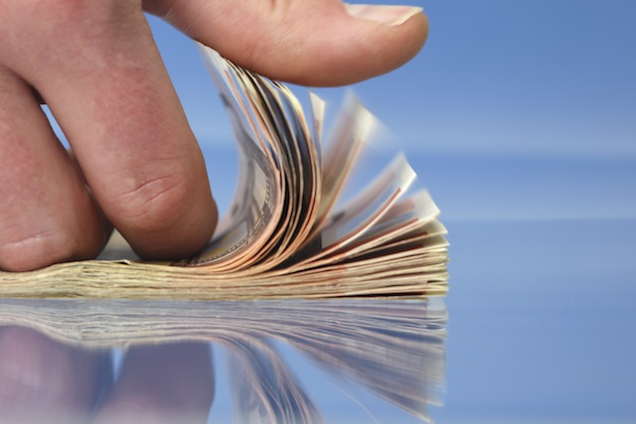
2. Count the Cost
Mark 8:36 “What does it profit a man to gain the whole world, & forfeit
his soul ?”
Time
Effort
Money
Awkwardness
“Luke 14:28 “For which one of you, when he wants to build a tower, does not first sit down and calculate the cost, to see if he has enough to complete it?”

Slide 12
3. List All Your Reasons
Heb 2:1 So we do not drift away from them
Like for Health:
No stroke
Family
Attack
Church
Diabetes
Sports
Die early
Feel good
Be sleek
Immune
4X less likely to get cancer;
260X less likely to get dementia.

Slide 13
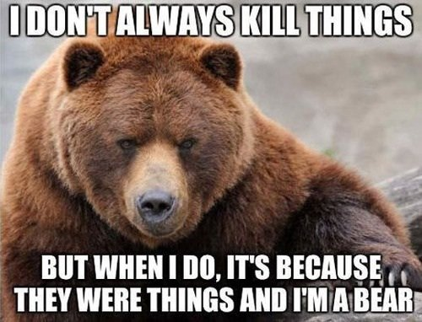

Slide 14
If it’s important
to you,
you’ll find
a way.
If not, you’ll
find an
excuse.

Slide 15
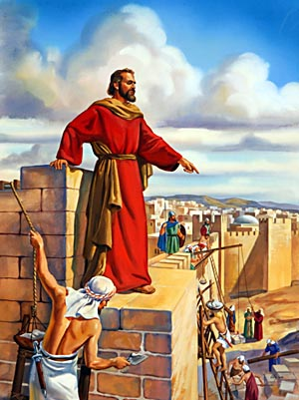
4. Split it Up
Nehemiah
2:4 Prayed to God.
2:5 Goal to rebuild Jeru.
2:6 Set a specific time.
2:7 Requested travel visas.
2:8 Requested bldg material.
2:13 Inspected the damage.
2:18 Motivated others to help rebuild.
You check professionals? Evaluate money?
Who can help? Plan the next several steps?

Slide 16

5. Take The 1st Step
“Those that
know their
God, will display
strength and Take Action” (Dan 11:32:b)

Slide 17

6. Track Your Progress!
Paul would remain for the Philippians’ Progress in the Faith (Phil 1:25)
Timothy give diligence that your Progress
may be evident to All. (1 Tim 4:15)

Slide 18
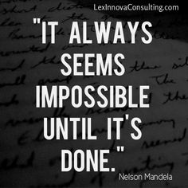

Slide 19

7. Reward It
Mat 25:21 “Well done good & faithful servants.
I will put you in charge
of many things.”
1 Cor 3:8 “Each will receive the reward
of his own labor.”
New type of exercise. Visit a new Park or Beach.
Weekend somewhere fun you’ve never been before. Get a New outfit. Take a fun class.
Notes:
My Healthy Choices Reward System
1 star for going to the gym
1 extra star for going to the gym three times in one week
1 star for walking at least 30 minutes
1 star for drinking at least six cups of water per day
2 stars for drinking eight or more cups of water per day
1 star for meeting my daily calorie goal
100 stars = I got a reward from my list
Give yourself permission to take a nap.
Take a Selfie to Celebrate your progress.
Spend an hour away from your phone or computer.
Clean out your closet and donate your unused clothes to charity.
Use smiley face or star stickers to note milestones on a wall calendar .
Unwind with a great movie.
Plan a night out with your friends.
Get a new driver's license photo.
Get a new workout song.
Get some new shades for outdoor exercise.
Invest is a fitness tracker to motivate you even more.
Sign up for a charity walk or running event.
Get a session with a personal trainer.
Plan a Dream vacation!

Slide 20

8. Expect Reversals
James 3:2 For we all stumble in many ways.
Prov 24:16 For a righteous man falls seven times, and rises again.
Eccl 1:15 “What is lack-ing cannot be counted.”
Rom 7:18b “The wishing is present in me, but the doing of the good is not.”

Slide 21

9. You Can Do It Thru Christ
(Ps 1:2-3 ) “Meditates in His law… shall prosper”
(Ps 84: 7 ) “They go from Strength to Strength”
(Prov 27: 17) “Iron sharpens iron …”
(Eccles 3:12) “Rejoice and do good.” (Phil 4:4)
(Phil 4:6 ) “Do no be anxious for anything.”
(Phil 3: 13) Forgetting lies behind, I press on
to what lies ahead.

Slide 22


Slide 23

Define Your Goal
Count the Cost
List Your Reasons
Split it Up
Take the 1st Step
Track Your Progress
Reward it
Expect Reversals
You Can Do It Thru Christ (Phil 4:13)

