Slide 1
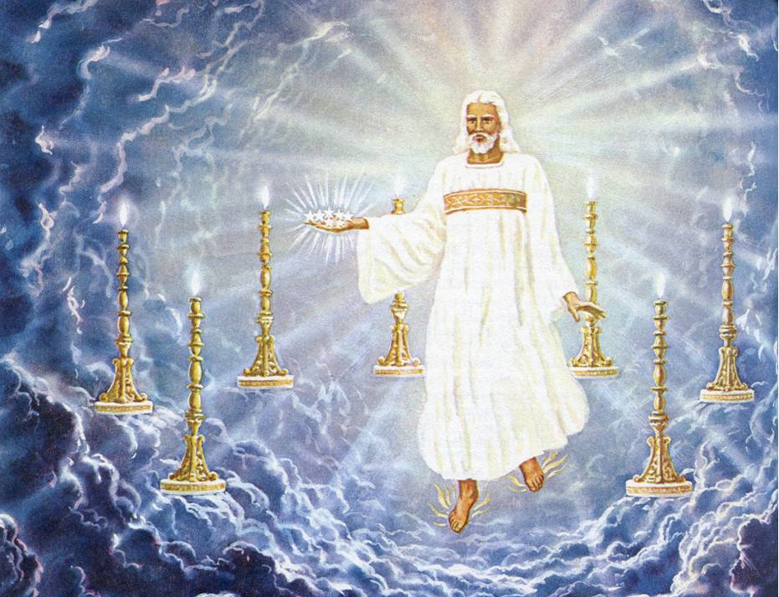
Rev 1: Christ Among the Lampstands

Slide 2
Rev 1: Christ Among the Lampstands
Purpose: To Instill Confidence in believers.
Theme :Victory of Christ over Satan.
We are More than
conquerors. (Rom 8:37)
No new doctrines here
Chap 1- 11 Man’s view of the Battle.
Chap 12-22 God’s view of the Battle

Slide 3
1:1-3 Revelation of Jesus Christ
1:1 The Revelation
Greek Apokálupsis
Apocalypse !
“To remove the cover; unveil”
1:1 Of Jesus Christ— Greek genitive case
means the revelation given by Him.

Slide 4
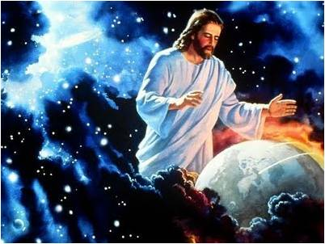
1:1-3 Revelation of Jesus Christ
1:1b “Revelation..
which God gave
Him to show...”
Deity gave
to Deity?
(John 7:16) My teaching is not Mine,
but His who sent Me (Jn 12:49; 14:24).
((The Son will subordinate himself to the
Father. (1 Cor 15:28) cf IVP; Pulpit.

Slide 5
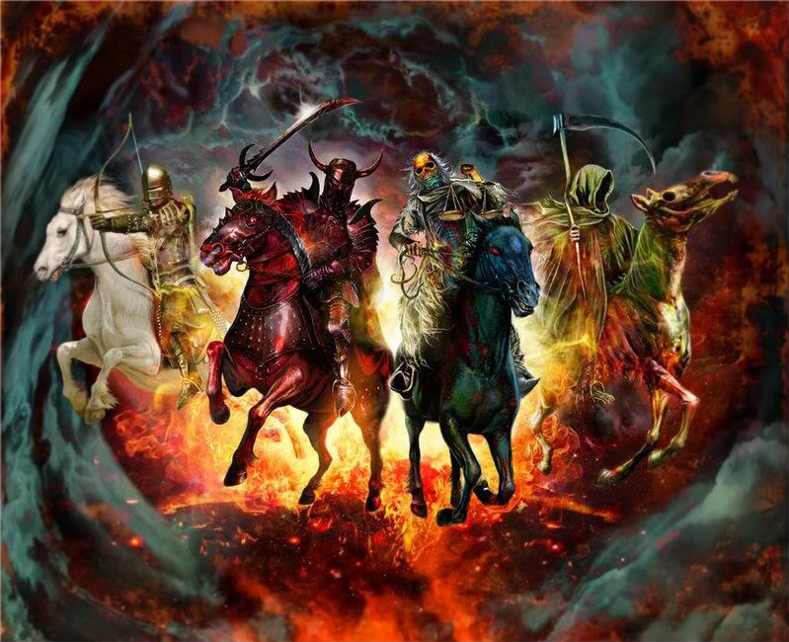
1:1-3 Revelation of Jesus Christ
Rev 1:1c “To show”: Greek = “Allow to See,
“To expose to the eyes.”
“To His bond-servants” Louw: “One that is Completely controlled by someone.”

Slide 6
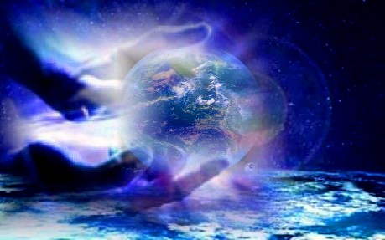
1:1-3 Revelation of Jesus Christ
1:1d Show the things which must shortly
come to pass
Happen in Brief space of time.
Some things would Happen after these things (Rev 1:19).
  Still others were FAR DISTANT.
  Satan sealed for 1,000 years (Rev 20:3)
  Later thrown into Lake of fire (Rev20: 7-10)

Slide 7
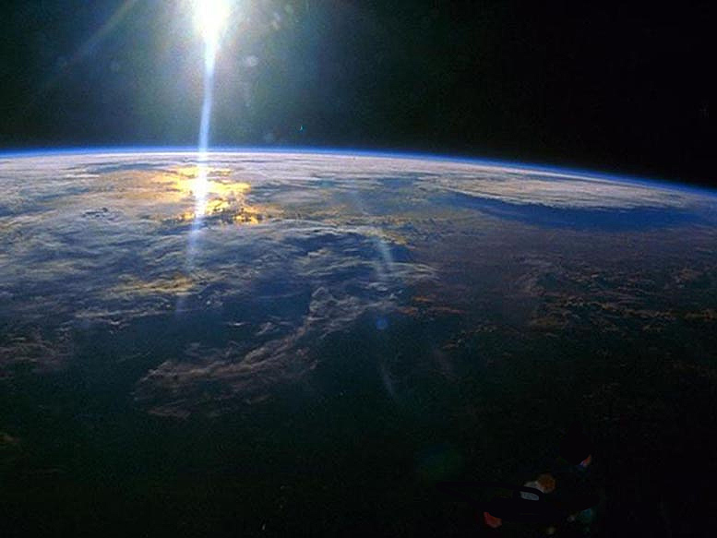
From
Father 1:1
1:1 “And He sent and communicated it by His angel to His bond-servant John.
To
Son 1:1
By HIS
Angel 1:1
to
John 1:1
to
Angels 2:1
to
Churches
2:7 f

Slide 8
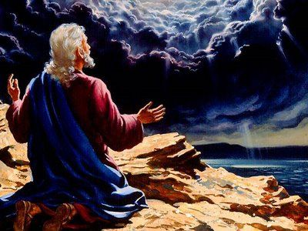
1:1-3 Revelation of Jesus Christ
1:2 [John] Who bore witness to the
word.. to all
that he saw
John is recording all that he “SAW”
in visions, just like other prophets.
( Ezk 1; Dan 2, Zech 6. )

Slide 9
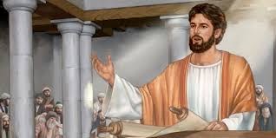
1:1-3 Revelation of Jesus Christ
v.3 “Blessed is
he who reads & those who hear..”
“the words of the prophecy & heed the things which
are written.” Jas 1:22
(1 Tim 4:13)
“Give attention to the public reading
of Scripture.” [They had no private Bibles]

Slide 10
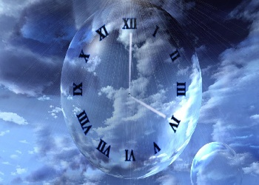
1:1-3 Revelation of Jesus Christ
1:3 “Blessed are those that… heed the things which are written in
it; for the time is
near.”
For Jesus his time was 36 hours away in (Mat 26:18)
Things would begin very shortly
What about You?
What about USA?

Slide 11
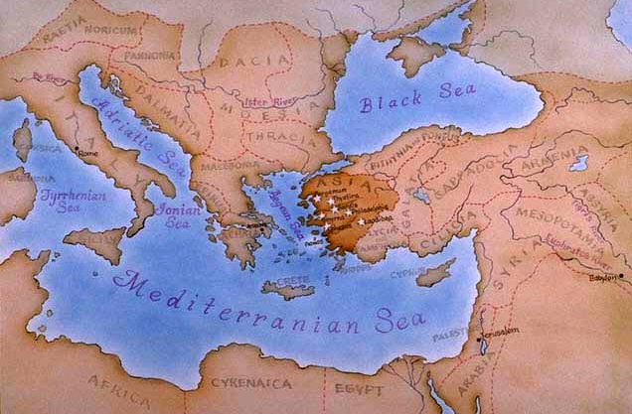
Rev 1:4 -8 Message to the 7 Churches
v.4 “John to the seven churches that are in Asia”
There were more
such as Troas, Colossae
and Hierapolis (Acts 20:4; Col 1:2; 4:13).
7 Because number of completeness? Or best cities for communication? Or all that’s left?

Slide 12
Rev 1:4 -8 Message to the 7 Churches
1:4 “Grace & Peace to you from…”
1:4 “Him who is and was & is to come”
The Father! The eternal “I AM” (Rev 1:8)
1:5 And from Jesus Christ: Son ! Tremendous comfort! Deity
is saying “ Grace and
peace to
you.”
1:4 Seven Spirits.. of God = Holy Spirit ! (v.5) The Spirit is the “Complete Light-Giver.”

Slide 13
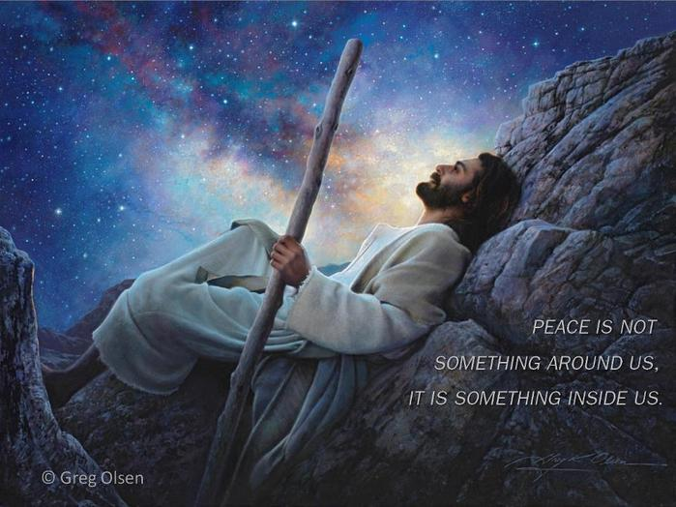

Slide 14
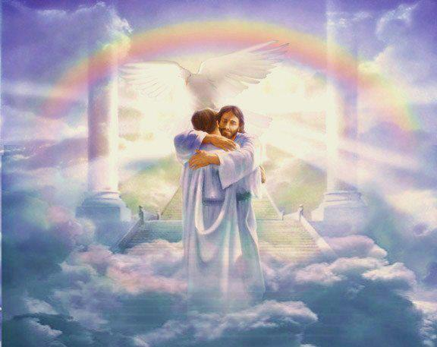
Rev 1:4 -8 Message to the 7 Churches
v.5 Faithful witness Totally trustworthy.
v.5 Firstborn of dead (1 Cor 15:20)
v.5 Ruler of kings (Rev 19:16)
v.5 Loves us (John 15:13)
v.5 Released from sins (Acts 22:16)
v.6 Be a kingdom (Col 1:13)
v.6 To be priests to Father (1 Pet 2:5) Royal
Tremendous Encouragement to the Saints !

Slide 15
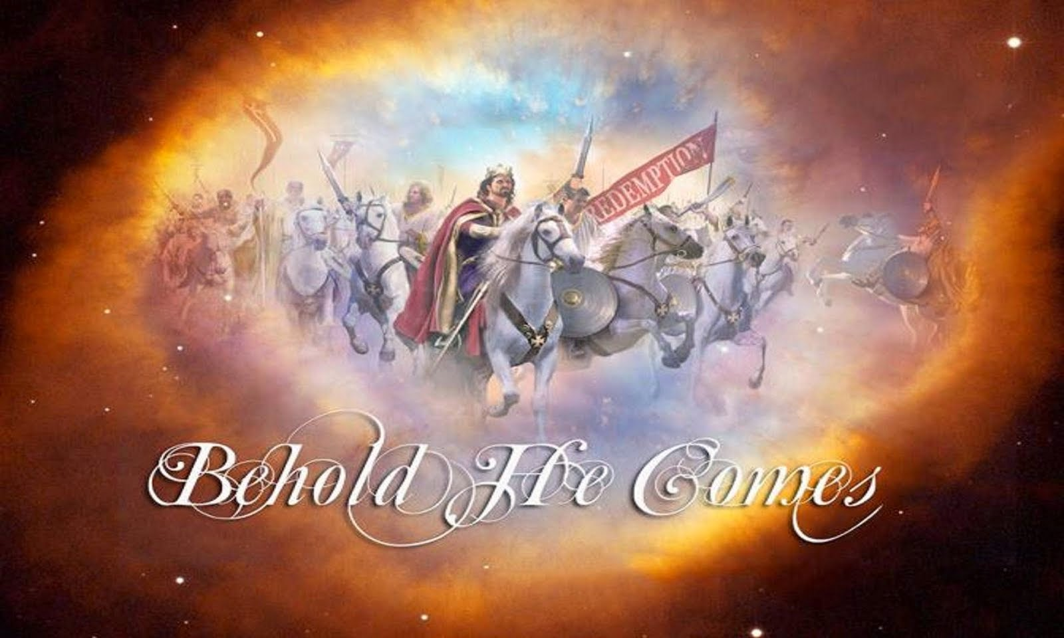
Rev 1:4 -8 Message to the 7 Churches
1:7 Behold he is coming with the clouds
Language of judgment
(Matt 24:30) “All the tribes of the earth will mourn, and they will see the Son of Man coming on the clouds of the sky with power and great glory.”
(Mat 24:34) That is the destruction of Jerusalem! The clouds are pictured as God’s chariots (Ps 104:3)

Slide 16
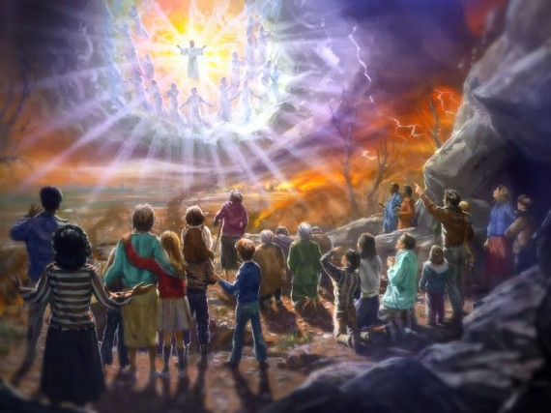
Rev 1:4 -8 Message to the 7 Churches
1:7 “And every eye will see Him, even those who pierced Him; and all the tribes of the earth will mourn
over Him.”
“All Tribes of earth [Jews & Greeks] Will be
overwhelmed with the apprehension of
the judgment to come. (cf. Barnes)

Slide 17

Rev 1:4 -8 Message to the 7 Churches
v.8 I am the Alpha and Omega says the Lord God … the Almighty
This is the Father’s self-designation.
(4:8-9) “Lord God Almighty who lives
forever and ever.”
But also later used by the Son (22:12-13)
“I am the Alpha & Omega.”

Slide 18
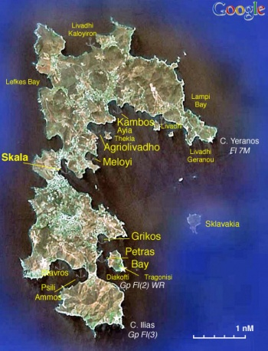
Rev 1:9 -11 The Command to Write !
1:9 I, John, your brother and fellow partaker in the tribu-lation and kingdom and perseverance which are in Jesus, was on the island called Patmos
One of a cluster of Aegean Islands, 10 mi long
x 6 mi wide. 24 miles off coast of Asia Minor.

Slide 19
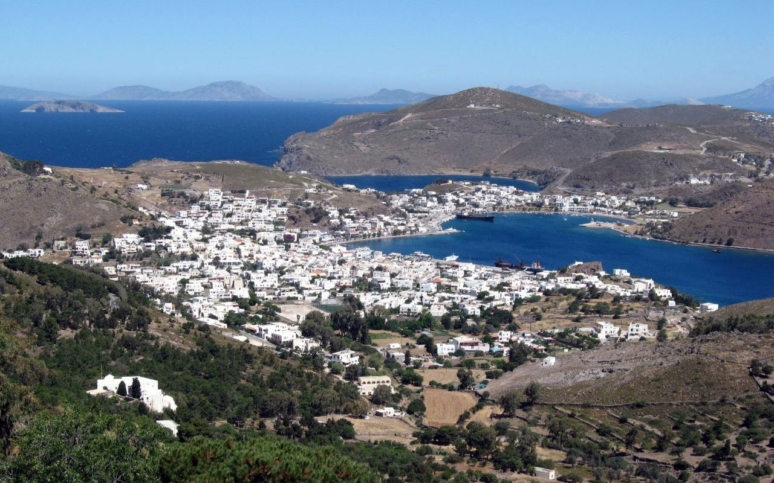
Rev 1:9 -11 The Command to Write !
Christians were regarded as criminals by emperor Domitian AD 81-96.
Rev 1:9 “Island of Patmos
because of the word of God and the testimony
of Jesus.
“An early Christian tradition said John was in
exile for 18 months.” Nelson’s Bible Dictionary

Slide 20
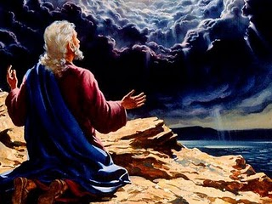
Rev 1:9 -11 The Command to Write !
Rev 1:10 “I, John was in the Spirit on the
Lord’s Day”
Like Paul (Acts 16:9 in Troas; 2 Cor 12:1-4);
And Peter in Caesarea. (Acts 10:9f)

Slide 21
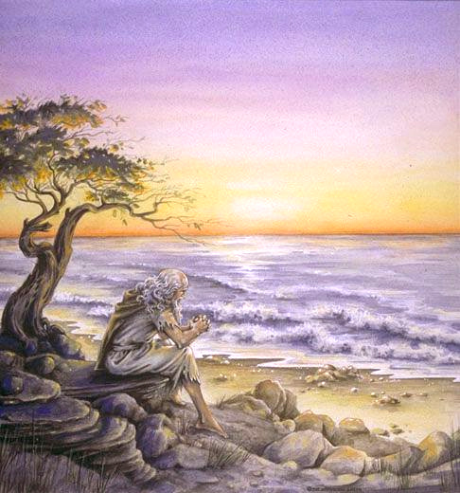
Rev 1:9 -11 The Command to Write !
v.10 “On the Lord’s Day”
Phrase: “Lord’s Day”
is used Only Here.
That day Jesus rose (Mat 28:1-6)
That day Lord’s church started
(Acts 2:1, 41)
That was the day Lord’s People
worshipped (Acts 20:7)
That was the day Lord’s People
people gave. (1 Cor 16:1-2)
His Visions begin
on SUNDAY !

Slide 22

Rev 1:9 -11 The Command to Write !
1:10 “I heard behind me a
LOUD VOICE, like the
sound of a trumpet”
A Trumpet sounded at Sinai (Ex 19:16, 19)
Trumpets warn people of attack. (Ezek 33:3)
1:11 Write in a book [Biblion] Diminutive:
“A small book, a scroll” Thayers.
Write what you see & send it to the 7 churches

Slide 23
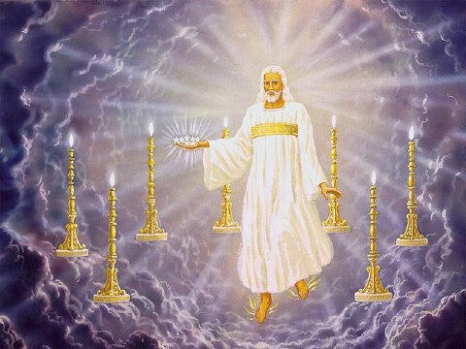


Rev 1:12 -20 Christ Among the Lampstands
v.12 I saw 7 golden lamp stands

Slide 24

Rev 1:12 -20 Christ Among the Lampstands
v.12 I saw 7 golden lamp stands
v.12 Lampstands = 7 churches (v.20)
v.13 Like the son of man = human form (Dan 7:13)
v.13 Robe, golden sash = HP. (Lev 8:7)
v.14 Hair, head white = purity (Heb 4:15; Dan 7:9)
v.14 Eyes a flame of fire = penetrating (Heb 4:13)
v.15 Feet.. burnished bronze = Strength (Dan 10:6)
v.15 Voice = Thunderous, stunning (Ezk. 43:2)
v.16 Two edged sword = The Word Cuts
(Eph 6:17; Rev 19:15 “Smite”).

Slide 25
Rev 1:12 -20 Christ Among the Lampstands
1:17 I fell at His feet as one dead
Daniel passed out too ! (Dan 10:9)
v.18 I was dead and… I am alive
forever more. I have the
keys of Death & of Hades
Comfort to the saints: I have experienced death and it Couldn’t hold me. Having the “keys of” means He has the AUTHORITY.

Slide 26

Rev 1:12 -20 Christ Among the Lampstands
Rev 1:19 "Write therefore the things which you have seen, and the things which are, and the things which shall take place after these things.”
Barnes “The more natural interpretation would seem to be, that it would stretch far into future years,.” (Barnes)
Isa 48:6 "You have heard; look at all this.
I proclaim to you new things from this time,
Even hidden things you have not known.”

Slide 27
Rev 1:12 -20 Christ Among the Lampstands
v.20 The mystery of the 7 stars
“The seven stars are 7 angels of the seven churches”
Probably NOT Guardian angels (2:1)
But HUMAN messengers or leaders.
Of Priests (Mal 2:7); prophets (Mt 11:10)
Perhaps church elders (Heb 13:17) Barnes

