Slide 1
Having The BEST Marriages

Slide 2

Having The BEST Marriages
In a Recent Survey:
Happily Married after 10⁺ Years?
28% = Yes.
21% = No.
41% = Depends on
which day you ask me !
Ques. Is your marriage in a rut ?
Startling 71% said Yes !
Notes:
We don’t want marriages that JUST stay the distance.
But we want to enjoy the journey, and give glory to God in the process.
Nobody likes a week old cup of coffee.
Nobody wants a marriage where you just go thru the motions.

Slide 3
How to have The BEST Marriages
}
Formula that Works:
B
lessings
This works
In Marriages
In Friendships
Raising Kids
In Medicine
In Academics
In Spirituality
E
ncouragement
S
haring
T
ouch

Slide 4
How to have The BEST Marriages
B
lessings
To praise or speak positively of someone.
To ask God to prosper or give blessings to.
1 Pet 3:9 “Not returning evil for evil, or in- sult for insult, but giving a blessing instead.”
It’s Not alright to yell back (Eph 4:31) or use
profanity (Eph 4:29) even if another does.
1 Cor 4:12 “Being reviled, we bless.”
Notes:
Some say: I don’t get mad—I get even ! (Unscriptural)
One person says something unkind-and another says it sharper.
You aren’t excused by saying–
“They started it”
“They MADE me angry.”
“That’s the way I was raised.”
“I can’t help it.”
Some people grew up in a yelling family—but it stops with you.
(Col 4:6) “Let your speech be always with grace.”
Prov 12:18 “There is one who speaks rashly like the thrusts of a sword,
But the tongue of the wise brings healing.”

Slide 5
How to have The BEST Marriages
E
ncourage
“To call to one’s side to give comfort.”
Col 4:8 Sent Tychicus to encourage your
1 Thes 5:11 Encourage one another, just as…
1 Thes 5:14 Encourage the fainthearted…
Titus 2:4 Encourage young women to love…
Be each others cheerleaders (Ephesians 5)
Wives hunger for love & cherishing (v.25, 29)
Husbands wants respect & appreciation (v.33)
Notes:
1. In a healthy home the positive comments should outweigh the negative 10:1
2. Our job is to make our mates & children feel as good about themselves as they possibly can.
But you have to be absolutely sincere.
When you express your love– you increase their capacity to love and to express it to others.
3. Husbands: specifically and repeatedly praise your wife.
It’s not good enough to look up and say “Yeah, you look alright.” : (
But you say, “Wow, you look GREAT in Red !” ☺
That way they know you really mean it.
Some husbands belittle wives—trying to be in control.
Rather than praising them and encouraging their willingness to follow.
4. Wives: Husbands bloom in an atmosphere of admiration and respect.
Or are you in the habit of belitteling?
Some wives do this to try to gain control from their husbands.

Slide 6
How to have The BEST Marriages
S
haring
Phil 2:18 “Share your joy with me (cf v 17)
Phil 4:3 “Shared my struggle in the cause”
Phil 4:15 “Shared with me giving [finances]”
1 Tim 4:3 “Foods gratefully shared in..”
You honestly share your fears, your dreams your hopes and your secrets that you may not share with the public.
Notes:
Marriage, church, kids, everything should be FUN — not drudgery to be dreaded.
Troubles shared—and halved !
Joys shared are doubled !
Share generously… bless and you will be blessed.
Some husbands are controlling—wife not allowed to know the finances.
Some families seldom eat together.
Some congregations don’t either– Ben Koltenbah experienced an odd one !
Today we’ll gather at the Knapps/Garretts community center for a going away party for Buel & Jennifer Noteboom.

Slide 7
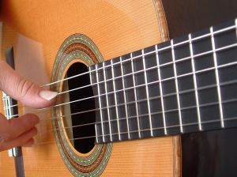
How to have The BEST Marriages
Marriage is like strings of a guitar vibrating to the same song…
But let there be spaces in
your togetherness..
And let the winds of the heavens
dance between.
Adapted from Kahil Gibran

Slide 8
GOD
Holy
Triumvirate
As we get
closer to
God..
We get closer to each
other.
Husband
Wife
The Triangle gets smaller and more intimate. Your spouse is 2nd only to God

Slide 9
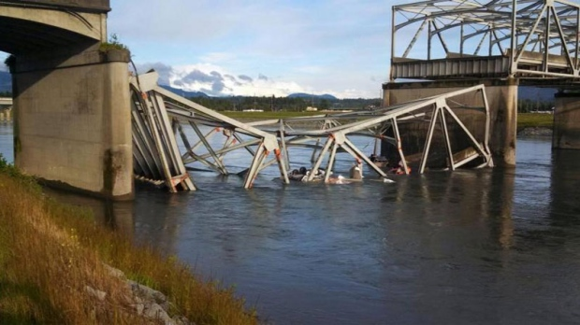

Repeated Damage Causes Failure
Skagit River Bridge May 23, 2013
Skagit River Bridge September 15, 2013
People don’t maintain their marital bridges
and they collapse.
But they CAN be rebuilt better than ever !
Notes:
Rebuild your bridges of communication
Look for things to do together—rather than apart.
Try new interests and see where it goes.

Slide 10
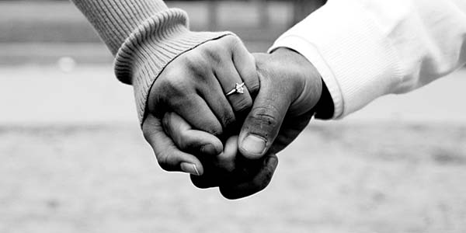
How to have The BEST Marriages
T
ouch
The Power of “Meaningful Touch”
Lowers our
blood pressure.
Makes us more positive about life
Strengthens our
immune system
Increases our energy level
A natural tranquilizer
Increases closeness
Increases our life span

Slide 11
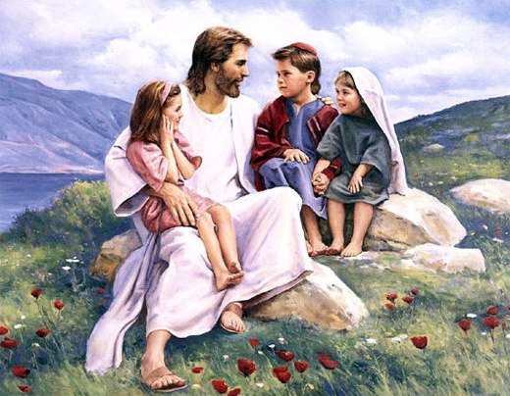
How to have The BEST Marriages
Meaningful
T
ouch
Children Mat 19:13
The Fearful Mt 17:7
Bind men Mat 9:29
Family Lk 15:20
Friends Acts 20:37
Sweetheart SS 2:6
The tender touch says “I care, I know the person behind the eyes.” Sit close,
hold hands in the car, snuggle.

Slide 12
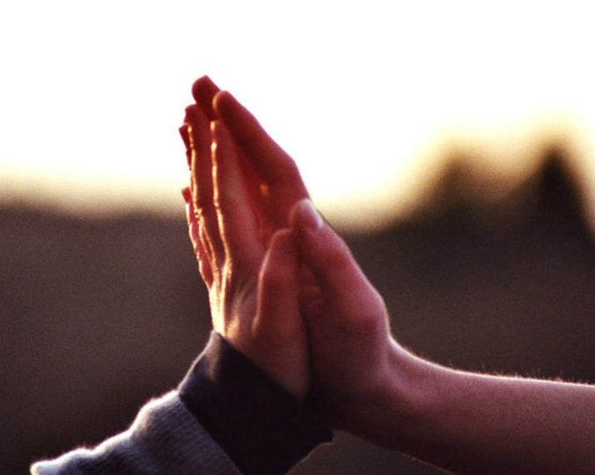
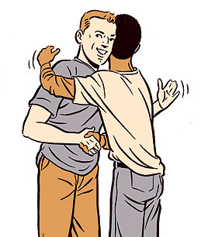
Type of Meaningful Touch
Guy hug
Friendly high five
Awkward hug
Romantic touch

Slide 13
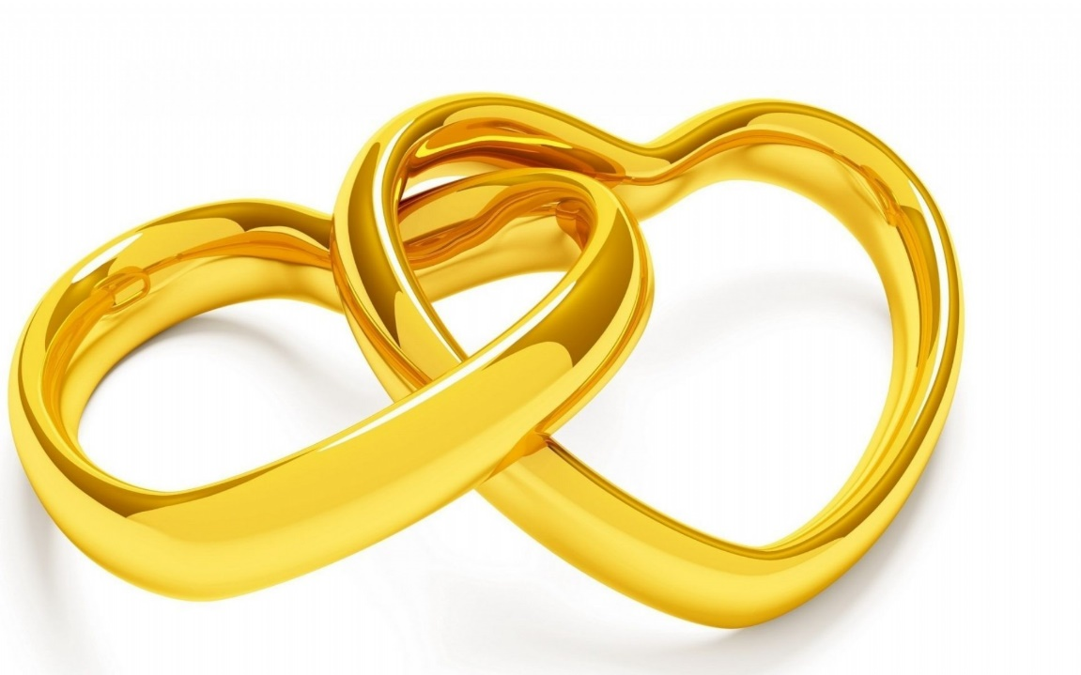
How to have The BEST Marriages
B
lessing
E
ncouraging
S
haring
T
ouching

