Slide 1

“The Joy of Unity”

Slide 2

The Joy of Unity
Phil 2:2 “Make my joy complete by being
of the same mind, maintaining the
same love,
united in
spirit ..”
Ps 133:1
“How good and how
pleasant it is for brothers
to dwell together in unity!”
Notes:
A congregation in a church in DALLAS was divided.
The division became so serious that each faction entered a lawsuit against the other to dispossess it from the church and to claim the church property.
This litigation came into newspapers, and many watched the court proceedings with interest.
The judge finally ruled it was not in the province of the civil court to settle this matter until it had first been aired before the church courts. So the matter was referred to the higher authorities in their denomination.
Eventually a church court assembled to hear both sides. Later the court made up its mind and awarded the property to one of the factions.
The losers withdrew and formed another church in the area.
It was reported in the newspapers for all Dallas to read that, in tracing this squabble to its sources, the court found the trouble began when an elder at a church dinner received a smaller slice of ham than a child seated next to him! (The Joy of Living, A Study of Philippians, p. 55).

Slide 3

On What Do We Have to Agree
to be in Fellowship ?
1. NOT in matters of Expediency
Meaning convenient
or practical.
(1 Cor 6:12) “Not all
things are profitable.”
KJV Bible? Carpet/color? Number songs?
New songs? PowerPoint? Sermon length? A/C ? Rest on Sunday? Stained glass?
Notes:
One Group in Tacoma—KJV only ! ☹
There are over 100 Bible versions mostly in English
As of November 2014 the full Bible has been translated into 531 languages, and partially translated into 2,883 languages.
Abbreviated Bible - TAB - 1971, eliminates duplications, includes the Apocrypha
American Standard Version - ASV - 1901, a.k.a. Standard American Edition, Revised Amplified Bible - AB - 1965, includes explanation of words within text
Aramaic Bible (Targums) - ABT - 1987, translated from the Hebrew into the Aramaic
Aramaic New Covenant - ANCJ - 1996, a translation and transliteration of the New Authentic New Testament - ANT - 1958
Basic Bible - TBB - 1950, based upon a vocabulary of 850 words
Contemporary English Version - CEV - 1992, includes Psalms and Proverbs
Coptic Version of the New Testament - CVNT - 1898, based on translations from Egypt
Cotton Patch Version - CPV - 1968, based on American ideas and Southern US culture, Geneva Bible - TGB - 1560, Version just prior to the translation of the KJV
International Standard Version - ISV - 1998
King James Version - KJV - 1611, a.k.a. Authorized Version,
Living Bible - LB - 1971, a paraphrase version
Message - TM - 1993, a translation in the street language of the day,
New American Standard Version - NAS - 1977
New King James Version - NKJ - 1990
New Testament in Plain English - WPE - 1963, a version using common words only
New World Translation - NWT - 1984 – JW Bible
Noli New Testament - NNT - 1961, the first and only book of its kind by an Eastern Restoration of Original Sacred Name Bible - SNB - 1976, a version whose concern is the true name and titles of the creator and his son
Restored New Testament - PRNT - 1914, a version giving an interpretation according to ancient philosophy and psychology
Scholars Version - SV - 1993, aka Five Gospels; what are, might be, and are not, the words of Jesus; contains the four gospels and the Gospel of Thomas
Scriptures (ISR) - SISR - 1998, traditional names replaced by Hebraic ones and words with pagan sources replaced
Septuagint - LXX - c. 200 BCE, the earliest version of the Old Testament scriptures, includes the Apocrypha
Word Made Fresh - WMF - 1988, a paraphrase with humor and familiar names and places for those who have no desire to read the Bible.
http://tyndalearchive.com/scriptures/index.htm

Slide 4
On What Do We Have to Agree
to be in Fellowship ?
2. NOT in doctrinal matters NOT affecting
collective action.
Individual belief, not affecting others.
Collective
Action
(2 Cor 5:10; Rom 14:2) “Each one receive..”
Military combat? Veils? Nature of Heaven?
Degrees of Hell? Purpose of Hades?

Slide 5

On What Do We Have to Agree
to be in Fellowship ?
3. NOT in doctrinal matters that COULD affect collective action, but Don’t.
Eg. instrumental music or recreation in bldg
A persuasion that is not taught James 3:1
One sees it as just expedient 1 Cor 10:24, 32
Or one may have a little doubt Ps 131:1
Diligent to preserve the unity of Spirit Eph 4:3

Slide 6

On What Do We Have to Agree
to be in Fellowship ?
4. BUT in doctrinal matters both see as Essential and Irreconcilable.
Jesus is Deity (John 1:1) and Resurrected (1 Cor 15:3). .
Necessity of Baptism.
(Acts 2:38; 1 Pet 3:21)
The Bible is Inspired. (2 Tim 3:16)
Prophets spoke by Holy Spirit. (2 Pet 1:21)

Slide 7
Attitudes that Support Unity
A. Could it be that they Love the Lord
as much as I ? (Rom 12:3; 1 Cor 16:22)
B. And they’re Honest till proven otherwise.
(1 Cor 13:7 Love hopes; Mt 7:1-2 not judge)
C. Could it be that “I” might be Wrong?
(1 Cor 8:1^{b}-2) Am I Omniscient? (Prv 21:2a)
D. Come, let’s Reason together. (Isa 1:18)
E. Humility & Selflessness central (Phil 2:3-4)

Slide 8
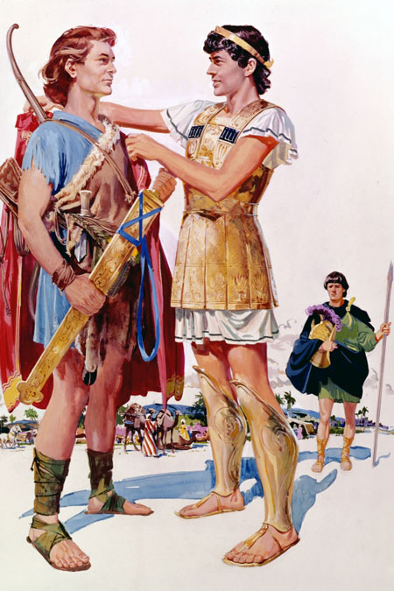
The Joy of Unity
1 Sam 18:1 It came
about … that the soul
of Jonathan was knit
to the soul of David,
and Jonathan loved
him as himself.
We’re building a Family
here and we’d like you to be a part of us.

Slide 9


