Slide 1

“Beautiful Lamb Of God”

Slide 2
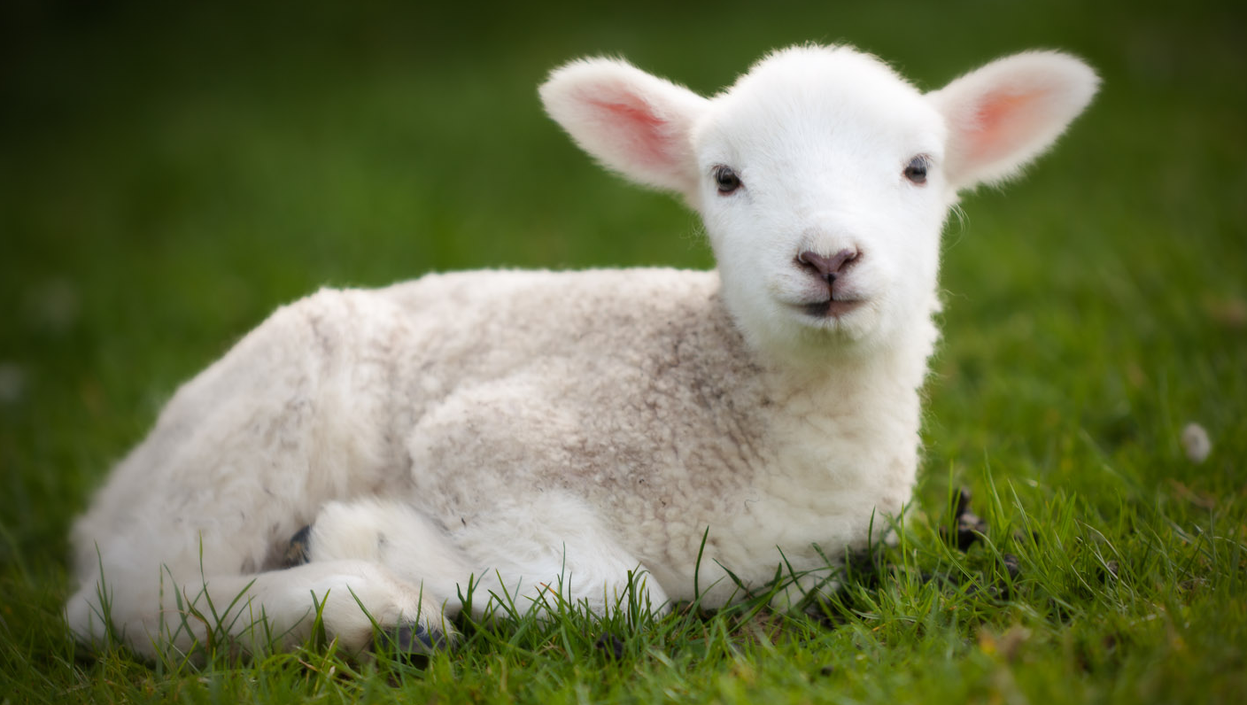
Song: Beautiful Lamb of God
John 1:36 Behold the Lamb of God
Other passages make reference to it:
(Isa 53:7) “Like a lamb led to slaughter.”

Slide 3
Passover Lamb
LAMB: “A young sheep; especially one that is less than one year old or with-out permanent teeth.
A baby sheep.”
Lamb First Commanded:
First Passover in Egypt
(Ex 12:3). One male lamb,
flawless, per household.

Slide 4
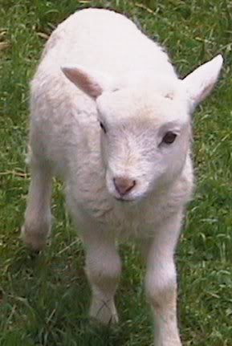
“Sacrificial” Lamb
Intent of Sacrifice:
Is Substitutionary!
Lev 17:11 “For the life of the flesh is in the blood & I have given it to you on the altar to make atonement for your souls; for it is the blood by reason of the life that makes atonement.”

Slide 5
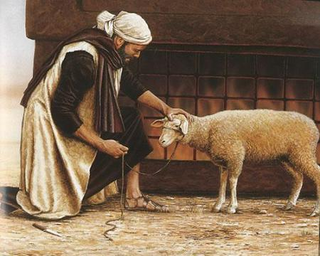
Substitutionary Sacrifice
Your Own Sacrifice
(Lev 1:2; 1 Chr 21:24)
You Lay Hands on
the animal (Lev 1:4)
You Confess Your
Sins (Nu 5:7)
You Slay your animal (Lev 1:5)
You Skin animal, wash, dissect it. (Lev 1:6,9)

Slide 6
Lamb of God, Guiltless
(Lev 1:3) “Shall offer
it, a male without defect.”
2 Cor 5:21 Him who knew No sin to
BE sin on our
behalf
Heb 4:15 Has been tempted in all things
as we are, yet without sin.

Slide 7
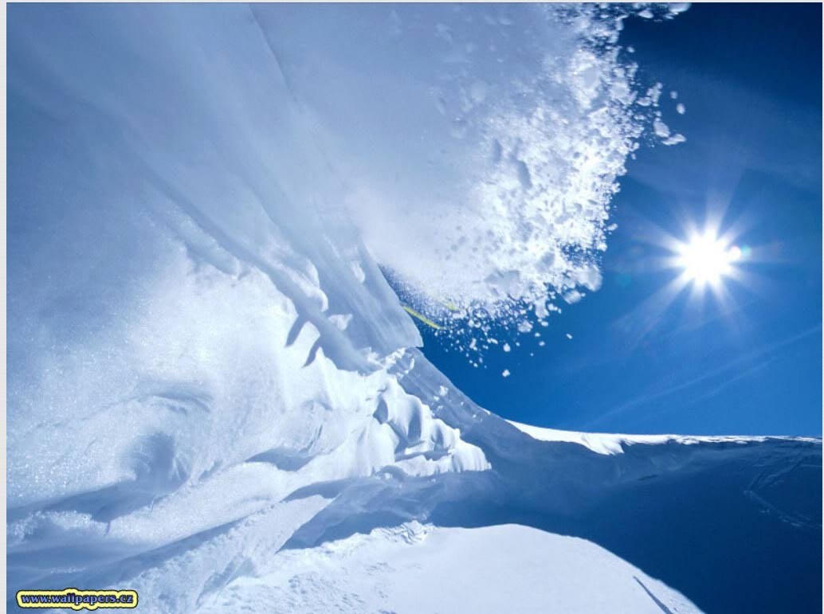
And Pure As Snow
John 8:46 "Which one of
you convicts Me of sin?”

Slide 8
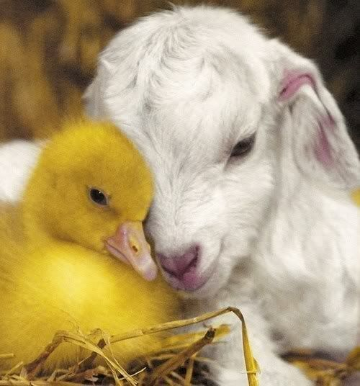
Gentle and Merciful
Mat 11:29 “I am
gentle..”
Mild, not harsh.
Matt 12:20 “Battered
reed He will not break off, and
a smoldering wick He will not put out.”
John 4:17-18 “You have had 5 husbands…”
John 8:11 “Neither do I condemn you...
Go… and sin no more.”
John 21:17 “Love me? Tend my sheep.”

Slide 9
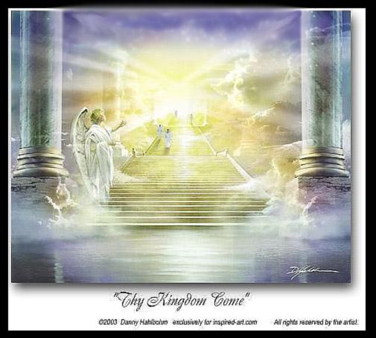
Sent from Father’s Love
Luke 22:42 “Not my will, but Yours be done.
John 3:16 “God so love the world that He
gave His only son.”
Gal 4:4 “When the fullness of the time had come, God sent forth His Son..”
John 17:18 “As You sent me into the world.”

Slide 10
Sent to Redeem With Blood
Ps 49:7 No man can by any means redeem his brother, or give to God a ransom for him — v8 For the redemption
of his soul is costly.
1 Peter 1:18 “You were redeemed from the empty way of life handed down to
you from your forefathers
v19.. with the precious Blood of Christ, a lamb without blemish or defect.
v20 He was chosen
before the creation of the world.”

Slide 11
Lamb.. Suffering Pain
Matt 27:26 Having Jesus scourged...
Matt 27:29 Weaving a crown of thorns, they
put it on His head.
Matt 27:35 Crucified Him.
(Has Hours to slowly die)
Matt 27:39f Were mocking Him
John 19:30 He said It is finished
John 19:34 Soldier pierced His side…

Slide 12
By His Wounds We’re Healed
Beautiful Lamb of God
Isa 53:5 He took our punishment
1 Peter 2:24 “He Himself bore our sins
in His body on the cross, that we might die to sin and live to righteousness;
for by His wounds you were healed.”

Slide 13
Like Sheep We’ve Gone Astray
Ps 119:176 “I have gone astray like a lost sheep.”
Isa 53:6 “All of us like sheep have gone as-tray, each of us has turned to his own
way; but the Lord has caused the iniquity of us all to fall on Him.”

Slide 14
Beautiful Lamb of God
John 15:13 Greater love has no one than this, that one lay down his life for his friends.
John 15:14 You are My friends, if you do what I command you.
John 10:18 "No one has taken it away from Me, but I lay it down on My own initiative.”

Slide 15
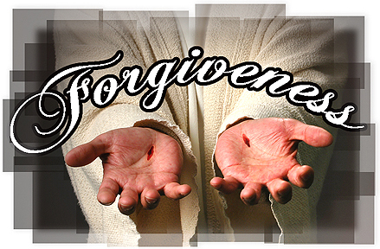
Beautiful Lamb of God
Are You Ready to Respond ?

