Slide 1
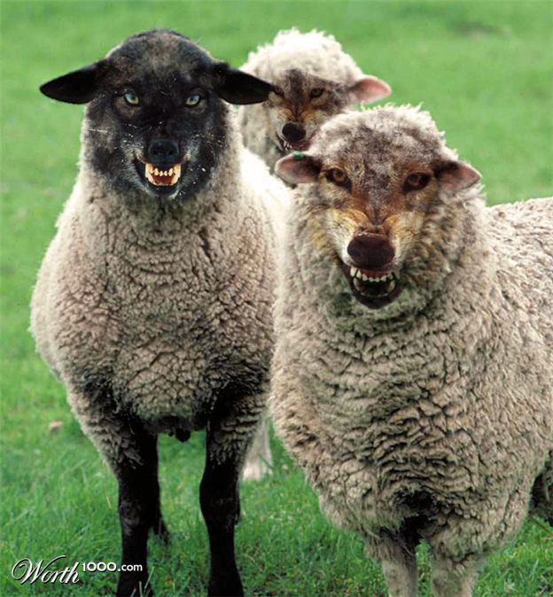
Titus 1:10-16 The False Teachers - REVIEW
Titus 1:10 There are many rebellious men, empty talkers and deceivers, especially those
of the circumcision,
Especially [Not only]…
“Converts from Judaism,
who rebel & deceive others
with their nonsense.” cf TEV

Slide 2
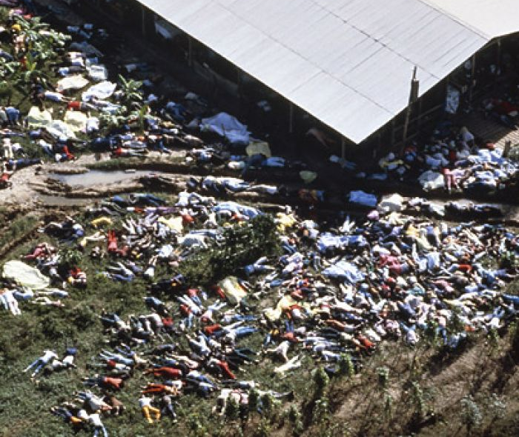
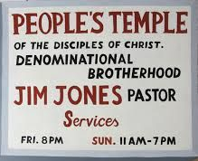
Review
Cult of Death
Sat Nov 18, 1978
909 die
Titus 1:15f Are Defiled. They profess to know God, but
by their deeds they deny Him, being detestable and disobedient, and worthless for any good deed.
Notes:
Jim Jones: Cult of Death
Jones himself was passionately committed to civil rights -- during the 1960s, he helped integrate churches, hospitals, restaurants, and movie theaters, and he personally adopted several children of color. (His only biological child, Stephan, had the middle name Gandhi.) The majority of the followers who died with him were African-American, and one third were children (140 age 10 or under. And a total of 304 for all children under 18).
Those who attended Temple services were drawn in by Jones’ passionate attacks on segregation and the “abuses, disgraces, and contradictions of American capitalism” (Jeffrey), as well as his dreams of a Utopian society
in which all members were treated equally, no matter their stature in the hierarchy of society.
In his speeches, Jim Jones certainly promoted this image and his role as a
crusader against injustice.
“I represent divine principle, total equality, a society where people own all things in common.
Where there is no rich or poor. Where there are no races. Wherever there [are] people struggling for justice and righteousness, there I am.” (Nelson).
Temple membership soon grew from several hundred to approximately 20,000 at the Temple’s peak in San Francisco, where Jones relocated the Temple in 1971 (UPI).
Jones as a Messianic figure and asked his followers to call him “Father”.
a. He staged “fraudulent psychic-healing” demonstrations using rotting animal organs as phony tumors;
b. Searched members’ trash for information to reveal in his fake psychic readings;
c. Drugged followers to make it appear as though he were actually raising the dead” (Webb).
d. He claimed that he was the reincarnation of Lenin and Jesus Christ.
Jones used the unquestioning devotion of his followers to increase their dependence on him
and isolated them from anyone outside of the Temple.
According to former Temple member Vernon Gosney, “Part of Jones’ philosophy was
that family relationships are sick and need to be broken down” (Ross, Rick).
Jones worked on breaking down connections between Temple members as well; he rearranged marriages and insisted on celibacy – a rule which he himself did not follow, having numerous sexual liaisons with both men and women.
Jones said: “Gays and lesbians who are “out” have faced suffering and ostracism; therefore, they are empathetic to the treatment of poor white people and racial minorities. Gays and lesbians are the most loyal people in the movement.
Michael Bellefontaine, “Everybody is a Homosexual,” Alternative Considerations 2007, retrieved 12 November 2015.
Gays and lesbians came to Peoples Temple due to the teaching that they were equal to everyone else.
This was the ultimate teaching Jones proclaimed, telling his members who true equality was achieved by saying that they were like God by having love within them and showing it to the world.
In getting rid of the idea of there being a “sky god” and also getting rid of the idea of a heaven in the sky,
members were taught to believe that they could be like God themselves and could create Heaven on Earth.
It was the members’ job to create Heaven on Earth with Jim Jones proclaiming, “Sharing together. That is our perfection. That is how we will build Heaven on Earth. That is how we will have God come out of the sky, and come down on Earth. And we do it ourselves.” “Q1059-3” FBI Peoples Temple Recording, Alternative Considerations, 1973.
Jones used public humiliation to further his control over people.
Former Temple member Elmer Mertle described a technique used by Jones called “catharsis,” a form of public humiliation.
“The first forms of punishment [in the Temple] were mental, where they would get up and totally disgrace and humiliate the person in front of the whole congregation. . . . Jim would then come over and put his arms around the person and say, ‘I realize that you went through a lot, but it was for the cause. Father loves you and you’re a stronger person now.
I can trust you more now that you’ve gone through and accepted this discipline.” (Kilduff and Tracy).
As to why the Mertle family stayed so long in the Temple, Mertle said, “We had nothing on the outside to get started in. We had given [the church] all our money. We had given all of our property. We had given up our jobs” (Kilduff and Tracy).
In response to this publicity he received enormous criticism and moved to Guyana in 1974.
He leased 3,800 acres of remote Jungle Terrain and called it Jonestown.
[In Guyana] he wielded more power over his congregation than he could have in the US.
There was no one in Guyana – in Peoples Temple – who would stand up to him, or even
get him to reflect on what he was doing, so he was unchecked.
Jones’ accelerated drug use also contributed to his increasing irrationality and fixation with maintaining control (Moore). His addiction, which had escalated from minor pharmaceutical usage earlier in his life, was only made apparent to most of his followers after the move to Jonestown, particularly because of the change in his style as an orator.
His speeches were increasingly fatalistic and began putting the idea of suicide into his followers’ minds: “I said, life is a DISEASE. It’s worse than cancer. And there’s only one cure for the’ disease. That’s death” (Ross, Rick).
Over the loudspeaker in Jonestown – which he used to preach to his congregation for hours every day – Jones’ speech was becoming increasingly slurred. The illusion of stability which Jones had maintained early on was completely destroyed.
Jones was unable to conceal his addiction from the group of journalists and Ryan’s aides who visited Peoples Temple. San Francisco reporter Ron Javers, who was wounded during the shooting that killed Ryan, recorded his observations at the time: “Jones has struck us as a madman. We watched him as he kept taking pills until he seemed dazed by them. He listed a whole catalogue of diseases he said were afflicting himr” (UPI).
The leader who had helped many of his followers get off of drugs was, by the end of Jonestown, using “uppers to help him stay awake, and then used downers to get to sleep” (Moore).
Drug use, compounded by pressure from several other sources – including a custody battle over one of Jones’ illegitimate children – made Jones turn on the community with more intensity.
Increasingly paranoid that his followers would turn against him, Jones went to greater lengths to assert his control by constantly testing his followers’ loyalty.
They had frequent suicide rehearsals called “White nights.”
Distributed cups with red liquid, saying in 40 min you will all be dead.
Jones also guaranteed that his followers were completely isolated from each other by creating a system encouraging people to inform on each others’ actions, which generated suspicion and paranoia between his followers.
If one follower openly expressed a desire to leave the Temple, those who heard him had to report him immediately, as the follower may have been speaking under Jones’ orders as a way of trapping them into agreement (O’Shea).
Children were encouraged to report on their parents. Jones further magnified his followers’ paranoia by pretending that he could read their minds. When Temple members died, Jones announced that he had killed them because he had read their thoughts and they had been thinking of leaving (O’Shea).
Sleep deprivation was perhaps the most effective weapon which Jones used to break down his followers’ psychologies. According to O’Shea, “One time Jim said to me… ‘Let’s keep them poor and tired, because if they’re poor they can’t escape and if they’re tired they can’t make plans’” (O’Shea). Followers were made to feel guilty if they slept for longer than several hours a night; they were expected to work six days a week and were perpetually exhausted. According to research, people who are sleep deprived “do not have the speed or creative abilities to cope with making quick but logical decisions, nor do they have the ability to implement them well” (Ledoux). The effect of sleep deprivation on the psyches of Jones’ followers no doubt significantly increased their willingness to take the cyanide at the time of the massacre.
In addition to crop failures, two-thirds of the Jonestown population had been weakened
by tropical diseases to which they had no built-in immunity (Hatfield).
In 1978, concerns raised by a group of relatives whose family members were in Jonestown drove Congressman Leo Ryan to investigate the situation in Guyana himself. He took with him to Jonestown a group of aides, journalists, and concerned relatives.
Ryan’s first impressions of the community were positive and admiring.
Yet after the welcoming ceremony for Ryan, reporters were slipped two notes which said, “Help us get out of Jonestown.” One woman approached Speier and said, “I’m being held prisoner here, I want to go home” (Nelson).
In the end, a group of 15 Temple defectors accompanied Ryan and his contingent to the Port Kaituma airstrip, where two planes were waiting to return to the States (Staebroek News). One of the defectors, who had been planted there, opened fire on the passengers inside of one of the planes as Temple members fired on Ryan’s contingent and the defectors outside of the second plane (Staebroek News). Five were killed and ten seriously wounded (Staebroek News).
Back at the compound, Jones had been seriously shaken by the defections.
According to O’Shea, “If he had let those people go, that would’ve been OK…but he saw every defection as a huge attack on his person” (O’Shea).
Jones called an emergency meeting and told his followers, “The congressman is dead! You think they’re going to allow us to get by with this? You must be insane. They’ll torture some of our children here. They’ll torture our people…We can not have this!” (Nelson)
He continued, “If we can’t live in peace, then let’s die in peace” (Nelson).
Jones began distributing Kool-Aid mixed with tranquilizers and cyanide in syringes, then brought out a vat full of the poison for the adults to drink from. Those who resisted were forced to drink, injected with cyanide, or shot by Jones’ security guards (Staebroek News).
Jones psychologically massacred his followers by leaving them no options and no way out.
Jones ordered that the children be poisoned first; by their parents (Ross).
By organizing the suicides in this way, Jones ensured that he severed the last ties which could have made some of his followers resist taking the poison – the bonds between parents and their children.
Jones first psychologically massacred the parents by making them watch their children die,
and then pushed them to their own deaths.
The people at Jonestown had been driven past the breaking point.
They had been beaten, sleep deprived, degraded, separated from their families, and stripped of all personal freedoms.
In the end, even the rigid structure of their lives at Jonestown had spiraled out of control.
Works Cited
AP. “Jonestown Questions Persist.” Bangor Daily News. 18 Nov. 1981. Print.
AP. “Papers: Jim Jones Used Sex to Rule, Blackmail Followers.” The Evening Independent [St. Petersburg]. 24 Nov. 1978. Print.
Brinton, Maurice. “Suicide for Socialism? Brinton on the Jonestown Massacre, 1978.” Libcom.org. 25 July 2005.
Chidester, David. Salvation and Suicide. Bloomington: Indiana University Press. 2003. Print.
Cockburn, Alexander. “‘Unabomber’ Ted Kaczynski Was CIA Mind Control Subject!” The Revelation @ The Forbidden Knowledge.Com. 9 July 1999.
Crewsdon, John M. “Followers Say Jim Jones Directed Voting Frauds.” New York Times. 17 Dec. 1978. Print.
Dittmann, Melissa. “Lessons from Jonestown.” American Psychological Association (APA). Nov. 2003.
“Find A Grave – Millions of Cemetery Records and Online Memorials.” Find A Grave – Millions of Cemetery Records. Jan. 2001. http://www.findagrave.com/.
Haney, Elissa. “The Jonestown Massacre: The Ministry of Terror.” Infoplease. 2007.
Hatfield, Larry D. “Utopian Nightmare.” SFGate. 13 Nov. 2008.
Jeffrey, Jason. “Who Was Jim Jones?” New Dawn Magazine. Jan. 1995.
Kilduff, Marshall. “The Trouble Starts: Drugs, Sex, Beatings, Defections.” The Modesto Bee. 5 Dec. 1978. Print.
Kilduff, Marshall, and Phil Tracy. “Inside Peoples Temple.” New West. 1 Aug. 1977: 30-38. Print.
King, Peter. “How Jones Used Drugs.” San Francisco Examiner. 28 Dec. 1978. Print.
Kohl, Laura Johnston. E-mail interview. 16 Apr. 2011.
Ksander, Yael. “Jim Jones | Moment of Indiana History – Indiana Public Media.” Indiana Public Media. 25 June 2007.
Ledoux, Sarah. “The Effects of Sleep Deprivation on Brain and Behavior.” Serendip (2001).
“Lester Kinsolving Series on Peoples Temple.” Alternative Considerations of Jonestown and Peoples Temple. 14 Sept. 2009.
Lindsey, Robert. “Enigma of Jim Jones: A ‘Saint’ Becomes a Devil.” The Day [Eastern Connecticut]. 29 Nov. 1978, 126th Ed, sec 1:1+. Print.
Mears, Walter R. “Is Religion Too Free?” The Milwaukee Journal. 30 Nov. 1978. Print.
Moore, Rebecca. E-mail interview. 18 Apr. 2011.
Moore, Rebecca. “The Sacrament of Suicide.” Alternative Considerations of Jonestown & Peoples Temple. 16 Nov. 2008.
Nelson, Stanley, Producer, Director. Jonestown: The Life and Death of Peoples Temple. WGBH American Experience. PBS Home Video, 2007. Transcript.
O’Shea, Teri Buford. Telephone interview. 16 Apr. 2011.
Parrish, Tina. “Leadership Styles: Martin Luther King vs. Jim Jones.” Alternative Considerations of Jonestown & Peoples Temple. 25 Jan. 2009.
Porter, Thomas. “History of MK-ULTRA. CIA Program on Mind Control.” Deep Black Magic. 1995.
Ross, Devin. “Culture, Charisma, and Peoples Temple.” Alternative Considerations of Jonestown & Peoples Temple. 16 Nov. 2008.
Ross, Rick. Jonestown: Jim Jones and the People’s Temple. The Rick Ross Institute, 1996-2008.
Staebroek News. “Jonestown 20 Years Later.” 22 Nov. 1998.
UPI. “Personality Spotlight: Rev. Jim Jones, Founder of the People’s Temple.” Florence Times. 23 Nov. 1978. Print.
Webb, Alvin B. “Jonestown Survivors Describe Their Escape.” The Bryan Times. 24 Nov. 1978. Print.
Wagner-Wilson, Leslie. E-mail interview. 16 Apr. 2011.

Slide 3
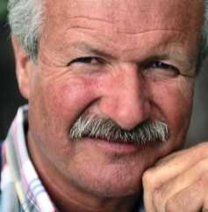
Titus 2:1-15 Christian Living
Titus 2:2 Older men are to be temperate, dignified, sensible, sound in faith, in love,
in perseverance.
Older: Presbutas> “Old man, aged.” Thayer
“An adult male advanced in years” Louw
Temperate: Nephalious> “Behaving in a restrained manner.” Louw “To exercise self-control.” NLT.
Thayers: 3524 Sober, temperate; “abstaining from wine, either entirely or at least from its immoderate use.”

Slide 4
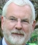
Titus 2:1-15 Christian Living
Titus 2:2 Older men are to be temperate, dignified, sensible, sound in faith, in love,
in perseverance.
Dignified: Semnous> “Honorable.” Vines
“Worthy of respect” NLT
Sensible: Sofranas> Moderate in behavior. Louw “To live wisely” NLT
Sound in faith: Hugi-ai-non-tas> Correct in one’s views, Louw. Healthy, Thayer
In Love: Agape> affection, good will, benevolence.
Perseverance: Hupomone> Steadfast, Unswerving.

Slide 5
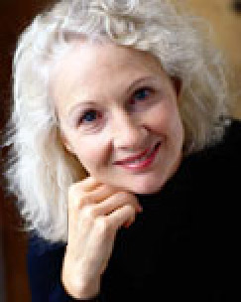
Titus 2:1-15 Christian Living
Titus 2:3 Older women likewise are to be reverent in their be-havior, not malicious gossips, nor enslaved to much wine, teaching what is good.
Older: Presbutidas> “An aged woman.” Thayers
Reverent in behavior: Hieropreis> “Befitting a sacred character.” Vines. Clothing, words, attitude
Not malicious gossips: Diabolos> “Those who are given to finding fault with the demeanor & conduct of others and spreading their innuendos & criti-cisms in the church.” cf. 2 Tim 3:3. Vine's

Slide 6
Titus 2:1-15 Christian Living
Titus 2:3 Older women likewise are to be reverent in their be-havior, not malicious gossips, nor enslaved to much wine, teaching what is good.
Not enslaved to much wine:
Mede Oinoo> Stumbling block 1 Cor 10:31-33
“Give no offense to Jews or Greeks or to the church”
Prov 23:29-35 Admonition against Intoxication.
Teaching what is good: Kalodisdaklos> Teacher of Good things (Prov 31:26) “Teaching of kindness”

Slide 7

Titus 2:1-15 Christian Living
Titus 2:4 That
[the older women]
may encourage the
young women…
v4 Young women: Greek neas— Youthful,
relatively young, the younger of two. Louw
v.4 To love their husbands and children NIV
Greek: Phil-androus… Philo-teknos>
Louw: Affection for one’s husband, children.
v5 To be sensible: Greek Sophronizo—Live wisely
NLT (ie disciplined)
v5 Pure: Greek hagnas: Free from defilement Vines

Slide 8
Titus 2:1-15 Christian Living
Titus 2:4 That
[the older women]
may encourage the
young women…
v5 Workers at home: “Taking care of household
concerns.” Thayers [doesn’t forbid other work]
v5 Kind: Greek Agathos: “Easy, gracious”—Vines (cf Eph 4:32) kind, tender hearted, forgiving”
v5 Subject to their own husbands: Subordinate.
v5 That the word of God may not be dishonored.
(2 Sam 12:14) Great occasion for enemies to blaspheme.

Slide 9

Titus 2:1-15 Christian Living
Titus 2:6 Likewise urge
the young men to
be sensible.
v6 Young men: Neo-terous.
“Relatively young” Louw
Timothy was youthful still
under age 40. (1 Tim 4:12)
Vincent.
v6 “To be sensible: Sophroneo. “Sound mind, to curb passions.” Thayer.

Slide 10

Titus 2:1-15 Christian Living
Titus 2:6 Likewise urge the
young men to be sensible.
v7 “Show yourself to be an example [tupos].
of good deeds.” A model— Louw
“A spiritual die that leaves an impression.”
v7 “With purity in doctrine: Uncorrupt Thayer
Not swayed by entreaties or bribes. Pulpit
v7 Dignified: Semnoteta. Generating respect.
v8 Sound in Speech Hugie “Healthy.”
Nothing rash or reprehensible.” Pulpit
“Beyond reproach, in order that the opponent may be put to shame, having nothing bad to say about us.”

Slide 11
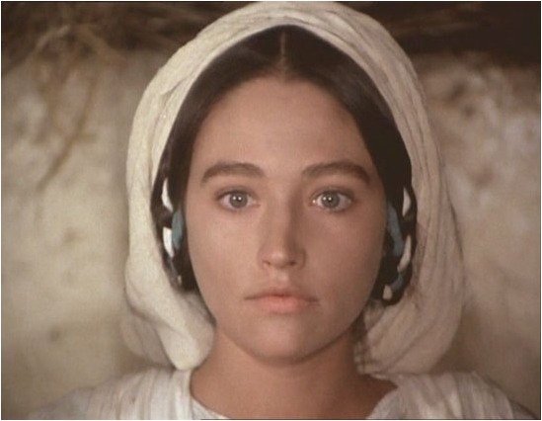
One might lose freedom in a number of ways
Titus 2:1-15 Christian Living
Titus 2:9 Urge Bondslaves
to be subject to their own masters in everything…
SLAVERY: Voluntary or involuntary
servitude to an individual with status … of property, for a period of time or in perpetuity . (ISBE)
Born by parents who are slaves. (Gen 17:22)
Captured as a prisoner & sold. (1 Sam 17:9)
Punishment for theft. (Ex 22:3)
Personal choice—to stay a slave. (Dt 15:17)
Titus 2:9 Be SUBJECT “To submit to one's control; to yield to one's admonition absolutely.” Thayer

Slide 12

Titus 2:1-15 Christian Living
Titus 2:9 Urge bondslaves [doulos]
to be well-pleasing, not argumentative
Please “so far as they lawfully may do… which are not contrary to the will of God.” (Eph 6:6-7) (Barnes)
Send her, not me.
I don’t want to.
It’s good enuff.
I can’t do it.
It’s not fair.
“Not contradicting, or not disobeying…
without attempting to argue the matter; without disputing with the master; and without advancing their own opinions.” (Barnes)
2:10 Not pilfering, but showing all good faith that they may adorn the doctrine of God our Savior in every respect.
Do not steal and discharge all your duties faithfully, so as to make Christianity even more attractive to others.

Slide 13

Titus 2:1-15 Christian Living
Titus 2:11 For the grace of God has appeared, bringing
salvation to all men.
Acts 17:30 “God is now declaring to
men that all everywhere should repent.”
John 3:16 "For God so loved the world...”
Rom 2:14 “When Gentiles who do not have the Law do instinctively the things of the Law .. are a law to themselves, ¹⁵ .. and their thoughts alternately accusing or else defending them.. ¹⁶ on the day
when, according to my gospel, God will judge
the secrets of men through Christ Jesus. ”

Slide 14

Titus 2:1-15 Christian Living
Cretans
Titus 2:12 Grace of God appeared
Instructing us to deny ungodliness & worldly desires & to live sensibly, righteously
& godly in
the present
age.
Present age: “By extension, the Messianic period.” Strong's

Slide 15

Titus 2:1-15 Christian Living
Titus 2:13 Looking for the blessed hope and the appearing of the glory of our great God and Savior, Christ Jesus.
Rev 1:7

Slide 16
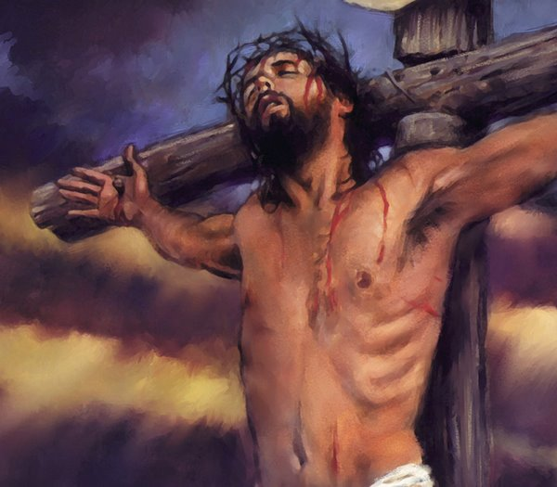
Titus 2:1-15 Christian Living
Titus 2:14
Who gave Himself for us, that He might redeem us from every lawless deed..
And purify
for Himself
a people for
His own possession, zealous for good deeds.
Isa 53:6 All of us like sheep have gone astray,
each of us has turned to his own way; but the
Lord has caused the iniquity of us all To fall on Him.

Slide 17
Titus 2:1-15 Christian Living
Titus 2:15 These things speak
& exhort and reprove with
all authority.
Let no one
disregard
you.
Preaching in NOT a popularity contest.
And it wasn’t for Elijah or Jeremiah either.
You’re God’s messenger not a country club manager.

Slide 18


